Slide 1
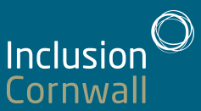
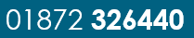
Welcome
Annual General Meeting
2021

Slide 2
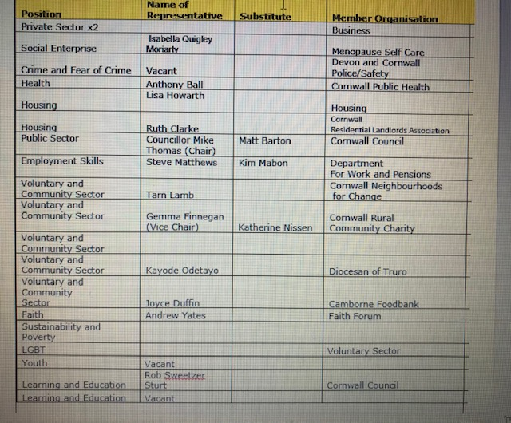
The Formal Bit
Election of Chair and Vice Chair – unopposed and thanked
Steering Group Member – welcome new members
Wider Membership – all residents of Cornwall
Constitution on the IC web-site

Slide 3
Our 18 Months
Inclusion Cornwall has supported Equality and Diversity development in Cornwall through the Countywide Cornwall Equality and Diversity Group
  We have drafted an Equalities Objective Document for Cornwall.
Provided an Inclusion voice for Cornwall throughout the pandemic.
  3 mail outs per week with information local and countywide
  Happy Friday’s – Pet’s Working from Home went down well during Covid
Inclusion Matters – working alongside Cornwall Rural Community Charity, Age UK, disAbility Cornwall.
Supporting Cornwall Council with Covid Responses in particular Food and Isolation across Cornwall
Provided funding to residents in need through the Covid Support Grant and the Covid Shielding Grant.
EU Settlement Scheme Support – long term residents upset about the scheme
Notes:
IC is and always should be strategic but that the Inclusion Hub offers a tactical response when there is a gap to be filled – whether that is leading on a bid on behalf of partners or brining organisations together to work differently

Slide 4
Covid Support
Inclusion Cornwall was identified as a partnership able to consider and fund where other organisations were constrained
Government Grant through Cornwall Council | Households
Covid Winter Grant – Department for Work and Pension | 64
Local Support Grant– Department for Work and Pension | 35
Clinically Extremely Vulnerable Grant – Department of Health and Social Care | 68

Slide 5
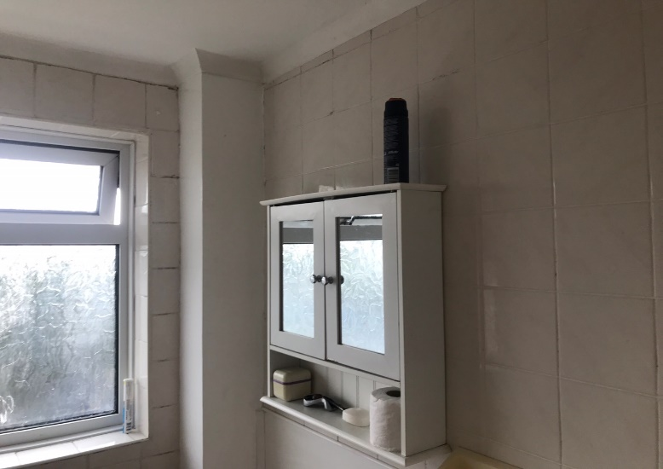
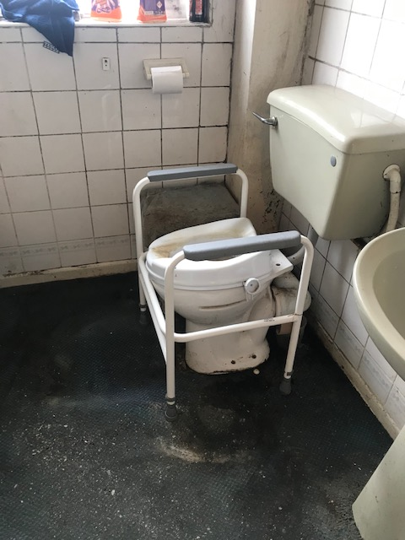
Toilets
After
Before

Slide 6
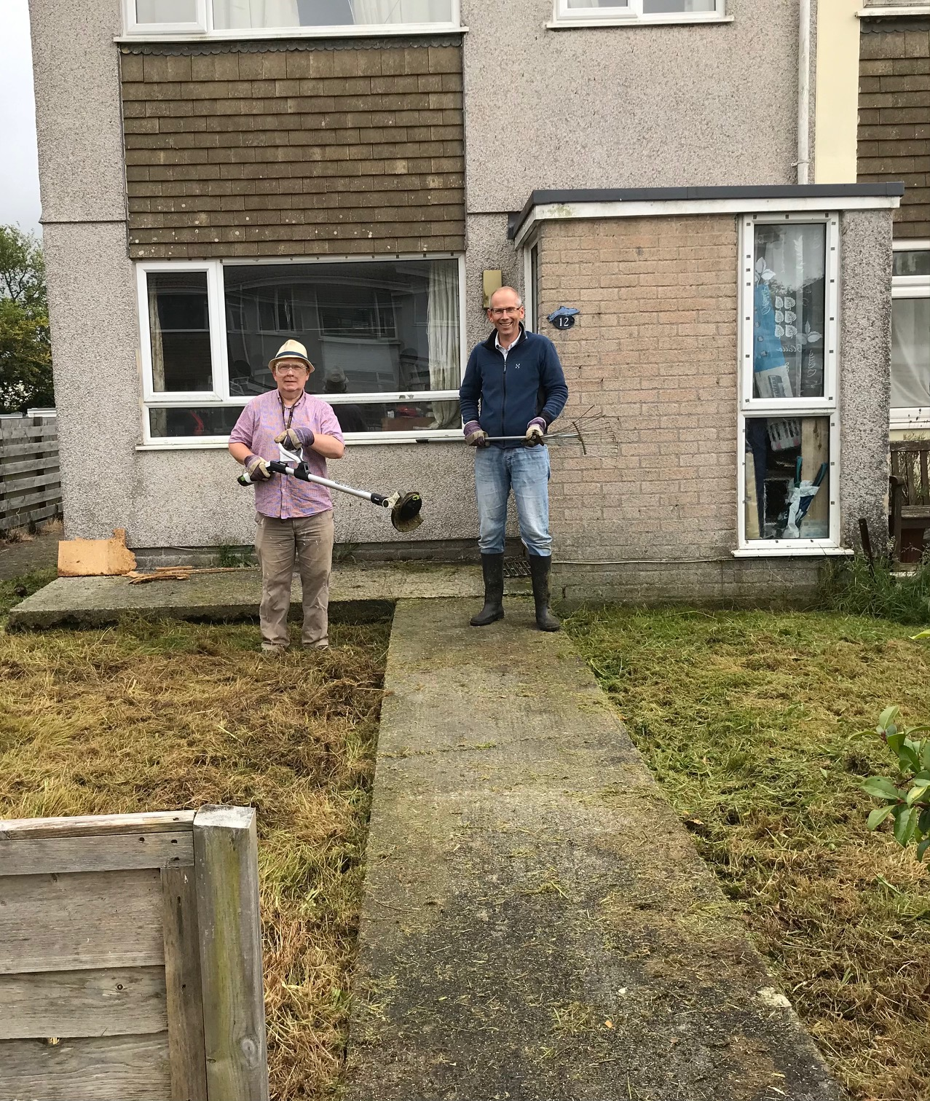
And Beyond
Spot
these
two here today!

Slide 7
Covid and IC support
Applications Open
Call the Hub for a chat 01872 326440
Complete application
White Goods
Carpets
Small Solar Panel
Toilet Repairs
Energy ( after going to CEP first)

Slide 8
The Inclusion Cornwall Hub
The Hub remains at our core providing support to partners and residents.
The Hub developed into a phone model of support and during Covid this continued and was known as a go to place for advice.
Over 500 referrals and general enquires managed – this figure is down on non-covid years as along with other partners many residents “vanished” for many months as Covid took hold.
  We now know that they were storing up issues and the need for support.
Continued work with Cornwall Council’s Discretionary team - during Covid where we worked to ensure customers received support
Notes:
IC is and always should be strategic but that the Inclusion Hub offers a tactical response when there is a gap to be filled – whether that is leading on a bid on behalf of partners or brining organisations together to work differently

Slide 9
Hub Referrals
The top 5 towns where the applicants live are as follows, in descending order:
St Austell
Redruth
Newquay
Camborne
Penzance
The top issues presenting are, in descending order:
Debt
Housing
Health
Skills
Benefits
No Surprises Here!?!
Notes:
IC is and always should be strategic but that the Inclusion Hub offers a tactical response when there is a gap to be filled – whether that is leading on a bid on behalf of partners or brining organisations together to work differently

Slide 10



Slide 11





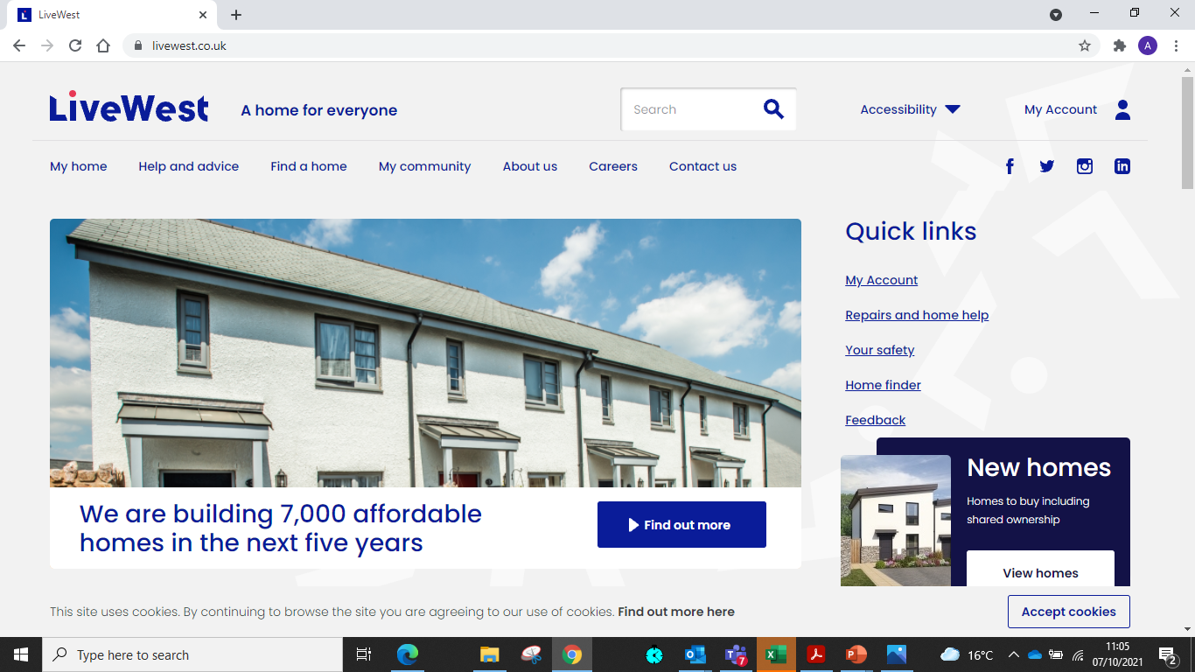

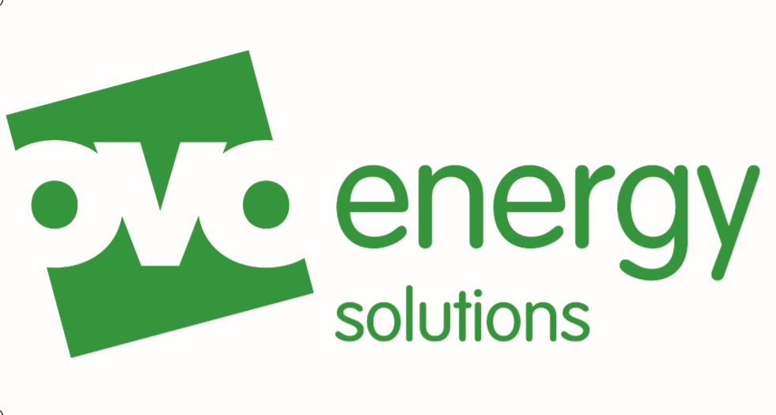








Winter Wellbeing Partners
Notes:
We are here today representing our partnership. Behind this is a delivery and referral network including NHS, the Voluntary & Community Sector and other key partners such as Age UK, Fire and Rescue service, Citizens Advice

Slide 12
Fuel poverty is
We should all be able to stay warm at home and healthy.
Rising energy costs, low incomes and energy-inefficient homes are restricting people’s options, leaving them in impossible situations – fuel, food, rent, mortgage.
30,000 in Cornwall (about 4m UK households)
It’s a national injustice which sees those with the least money having no choice but to live in homes that are the most difficult and expensive to heat.
The impacts
Cold homes can cause or worsen a range of serious health conditions, impact on mental health and is a known risk factor for suicide. Prevent children from thriving.
The collective impact on society is significant too. £1.3bn is spent each year on health services in England on treating illness caused by cold homes; and 20% of the UK’s carbon emissions come from housing.
The solutions
It is not inevitable.

Slide 13
A drug called “Heating”
Generic name | Being warm, boilers, central heating, hot water, radiators
Other brand names | Heating, energy, gas, electric, renewables, insulation, coal, wood, hot water, affordable warmth fuel poverty, solar
Indications | Struggling to pay for energy, draughty home, cold home, old heating, damp, mould, condensation, trouble breathing, not eating
Dosage | Able to turn heating on and afford. Daily when cold or damp
Administration | Personal control
Side effects | Improved health and wellbeing, social esteem, independence, better able to manage pre-existing health issues, preventative, best start in life

Slide 14
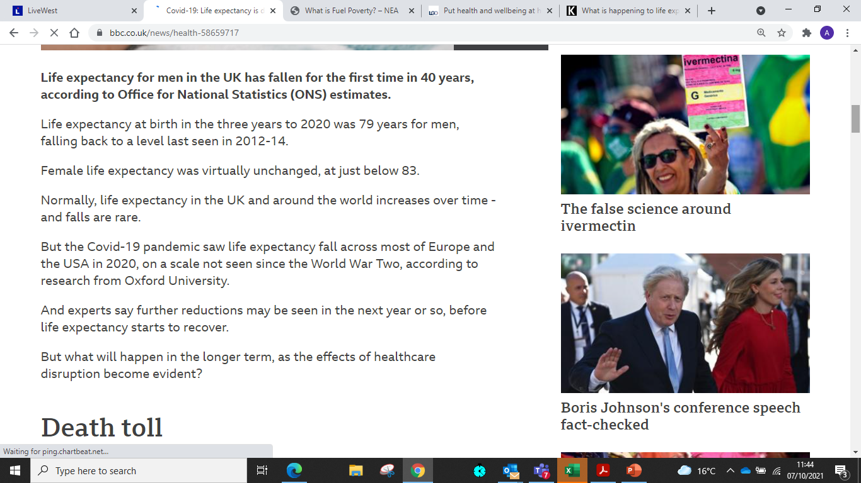
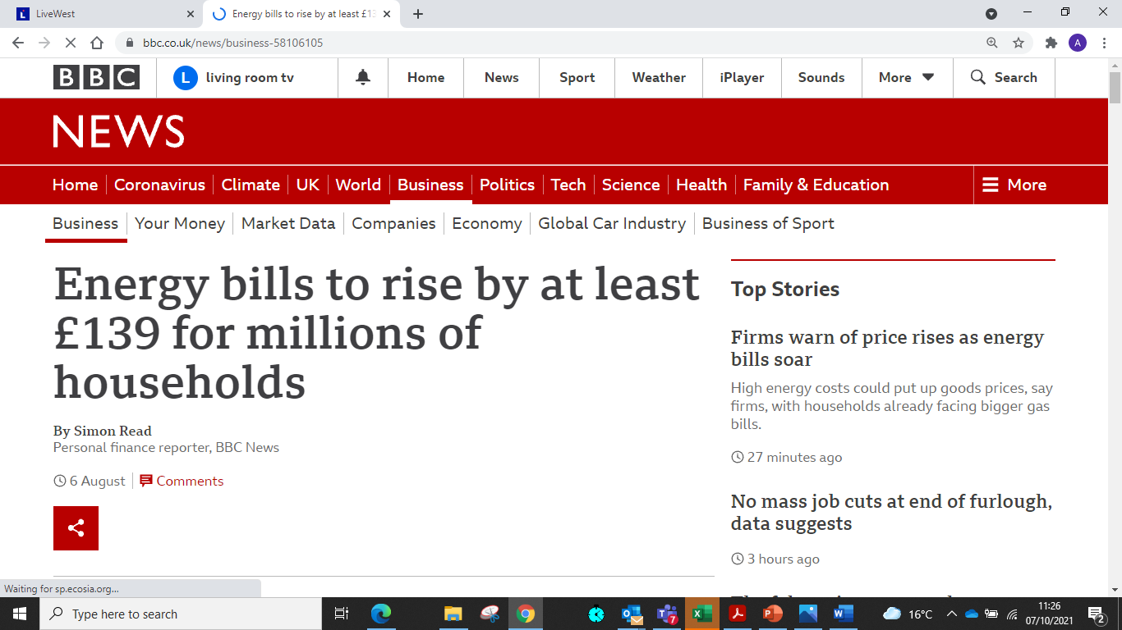
Focus on Fuel Poverty, improving health and Progress to Work
Investment in energy insulation and heating
Warm Homes Fund and Green Homes Grant - 1700
Local Authority flexible eligibility programme – 900
Sustainable Warmth bid – 400
Whole House Retrofit – 80
Revenue - help with running costs
Warm Home Discount Industry Initiative (WHDii) funded service – 613 (213 last Winter)
COVID Grants – 800 (since January 2021)
Notes:
Winter Wellbeing – Track record of 7 years of delivering fuel poverty programme..generally reactive with some preventative measures
Unique - only one in England that offers Reducing Fuel Poverty, Improving Health and Progress to Work
Links health and work outcomes ..reduces healthcare admissions…promotes mental wellbeing and economic outcomes.
Uses NICE guidance to direct and improve our approach
(13,000 people *based on average household size of 2.27 per home)
I appreciate WHF will not fund emergency help..but we can and this “wraparound” type service can be invaluable to encourage the more vulnerable to consider a new heating system.

Slide 15


Village Works
Born from - Helston and the Lizard Works 2015-2018 with Helston Town Council funded by Jobcentre Plus and HTC
(community enhancing opportunities for volunteers to gain skills and confidence)
Notes:
We are Village Works – part of Inclusion Cornwall (Cornwall Council) and funded through the European Social Fund.
We are an action research project and we have designed the project to work as part of the community helping our unemployed and inactive towards and into work. Some people will never work but many who think they can’t can with our support.

Slide 16
What is so special about Village Works?
Bespoke, not a one size fits all
Not time limited support to the person
A Barrier Busting fund to support the individual
Access to Inclusion Cornwall (funds and their network of providers)
Works with any Town or Parish Council – develops an idea with our customers for the good of any given community
Works with local businesses
A Village Approach to supporting the unemployed

Slide 17
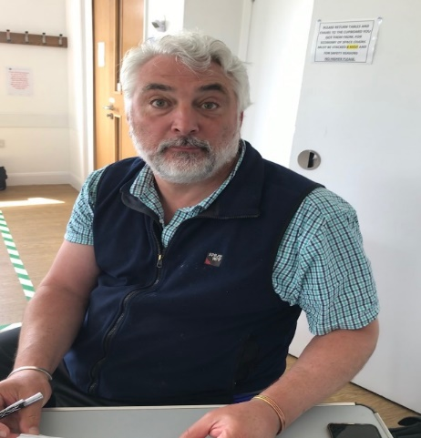
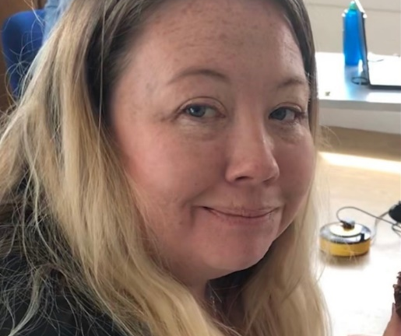
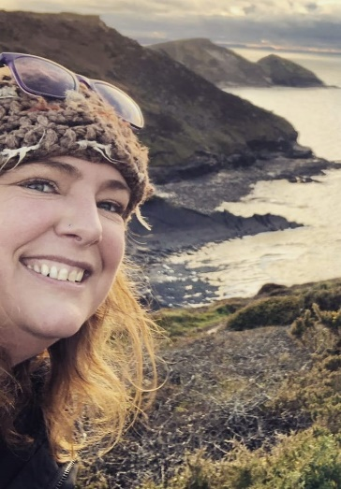
Meet the Team
Village Coach – Andrew Harry – 07570074374 Helston
  One to one support (at home or a venue of choice) – moving towards engagement, activities
    Offer group support
    Unique & bespoke support for the individual
Village Spotter – Nat Goldsworthy – 07947976515 Helston
        Naomi West – 07597528780 Bude
  Work with community leaders (Town and Parish Councils critical), community groups, volunteers, businesses, Job Centres
  Develop a peer network – Natters, Noshes, Walks
  Building community ownership of the unemployed and the isolated
Notes:
Key roles to the project and what they do
Triangle Consulting Star - action plan that Village Work’s Coach work through together with customers to help understand barriers and how to move customer forwards. We use these to develop SMART person centred goals.

Slide 18
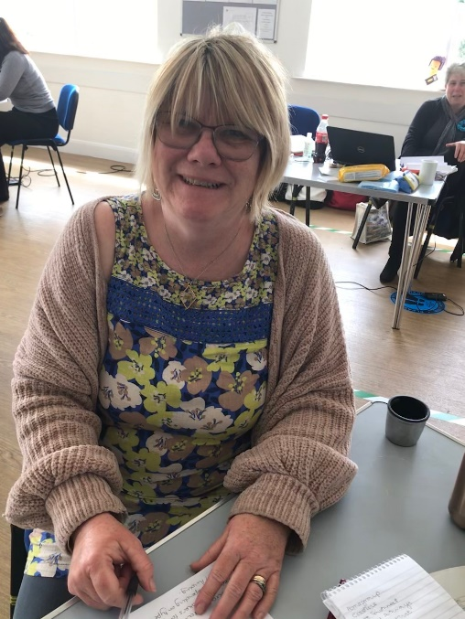
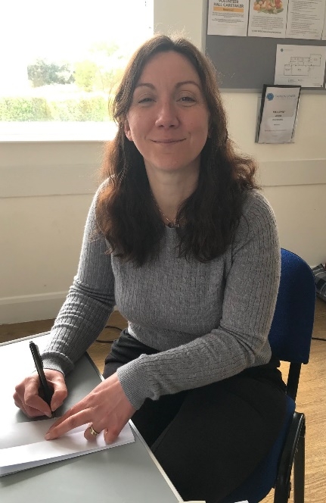
Disability Specialist - Adele Nankervis
01736 759500
  One to one support
  Benefit advice
  Linking to health support
Our Administrator – Sapphire McDermott
01872 326440
Part of VW and Working Alongside:
On Line Support Workers from Digital Inclusion
Financial experts from CAC
Kernow Credit Union
Notes:
Key roles to the project and what they do
Triangle Consulting Star - action plan that Village Work’s Coach work through together with customers to help understand barriers and how to move customer forwards. We use these to develop SMART person centred goals.

Slide 20
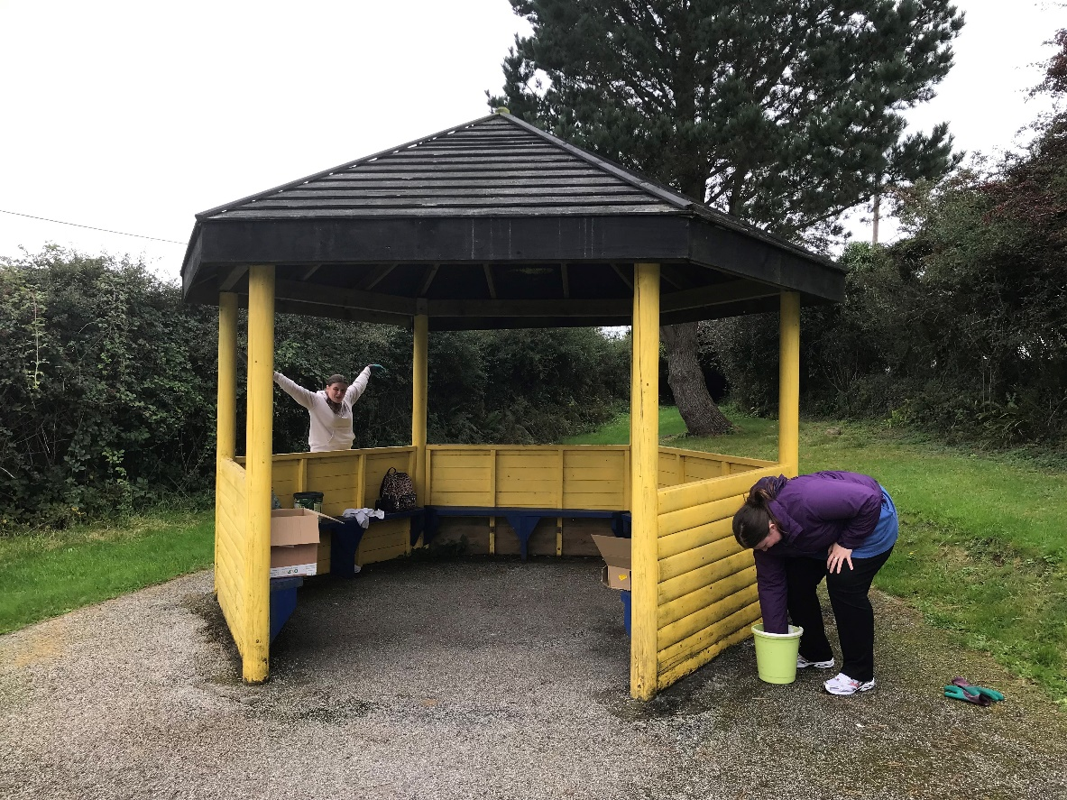
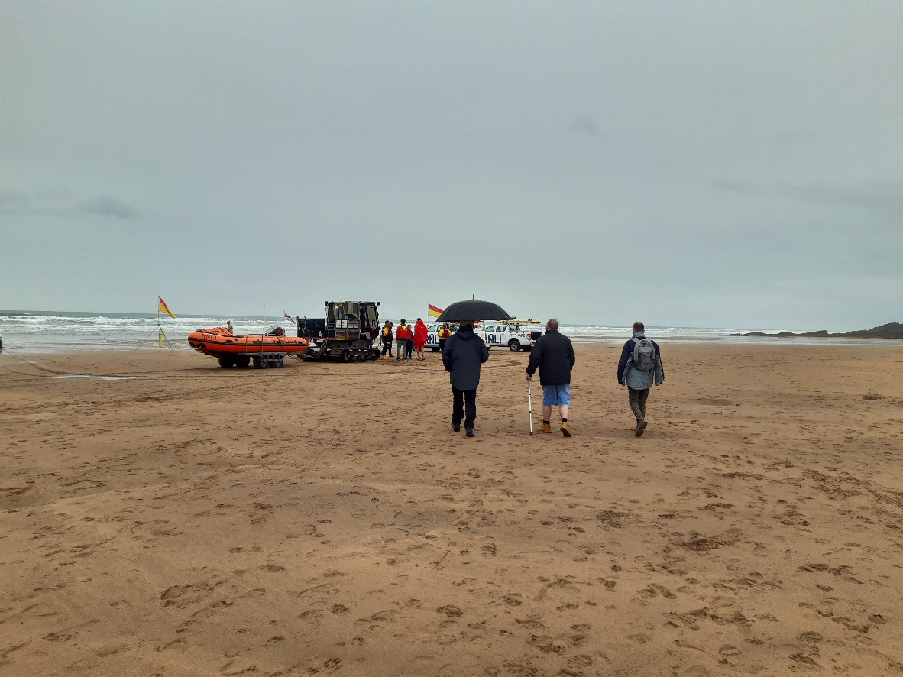
Painting at Breage Playing Fields
6 Oct 2021
Bude Walking group
(Re-starts on Monday!)

Slide 21
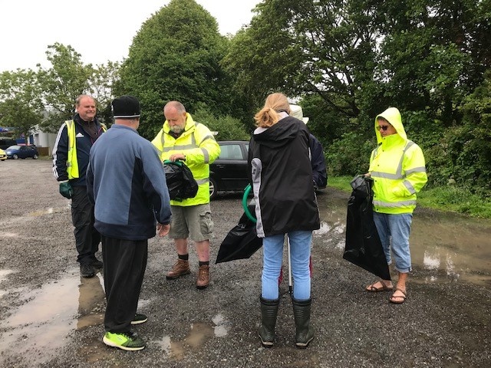
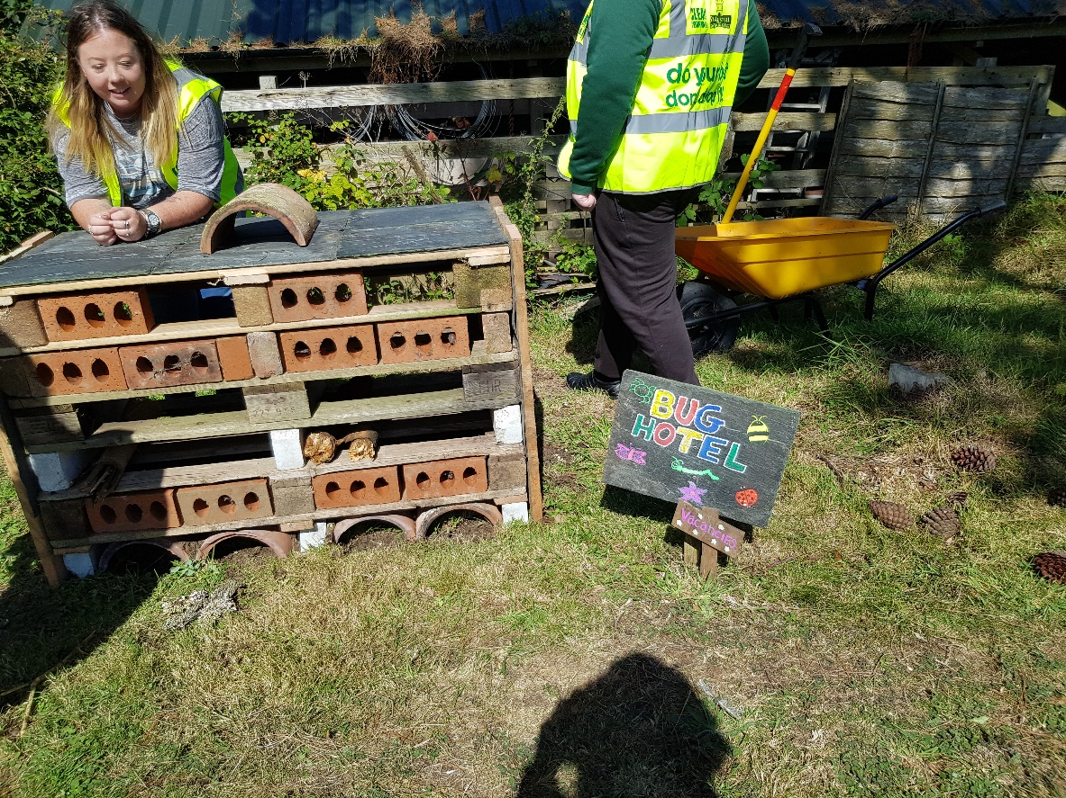
Litter pick 7 July 2021
Polventon Care Home Sept 2021
This Photo by Unknown Author is licensed under CC BY-NC-ND

Slide 22
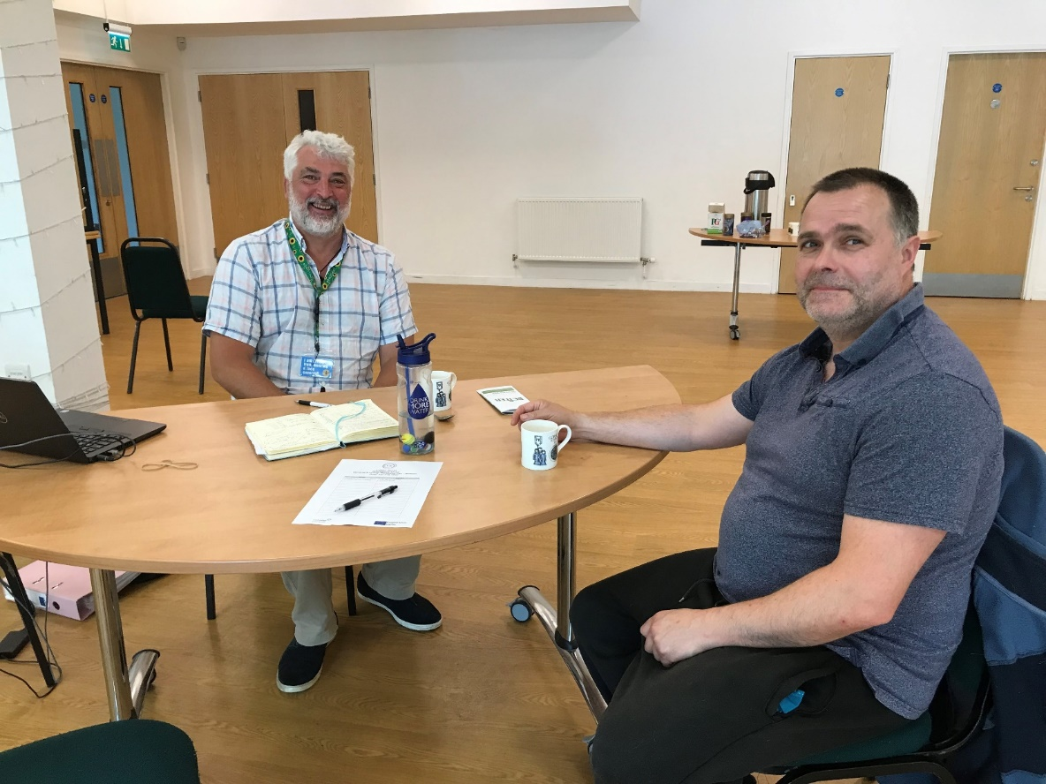
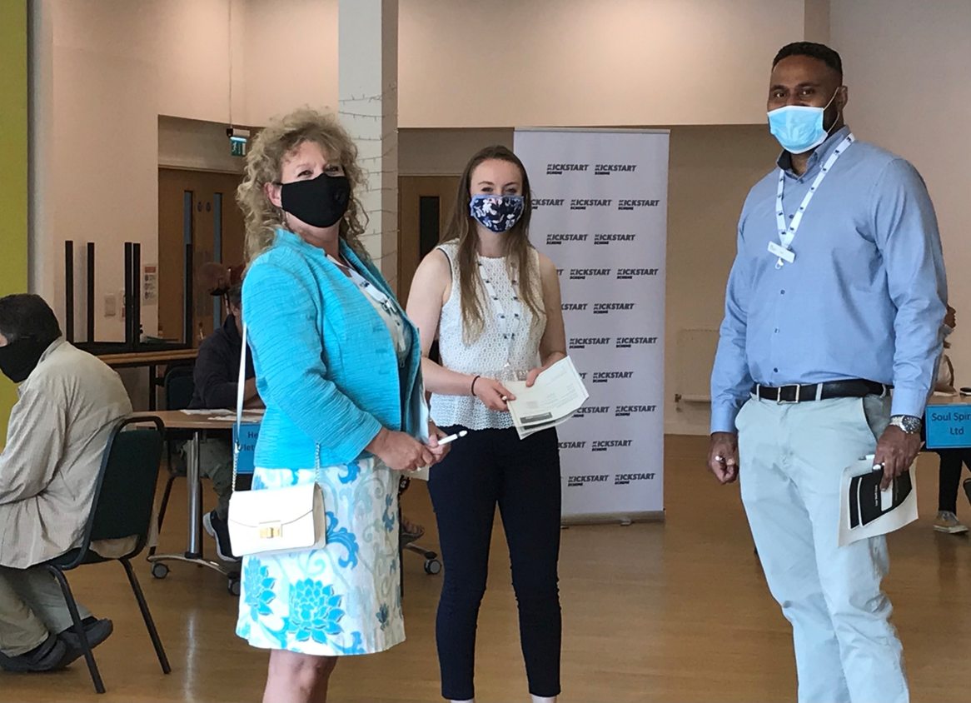
The Old Cattle Market Helston
Working with JCP to promote KickStart and Village Works
This Photo by Unknown Author is licensed under CC BY-NC-ND

Slide 23
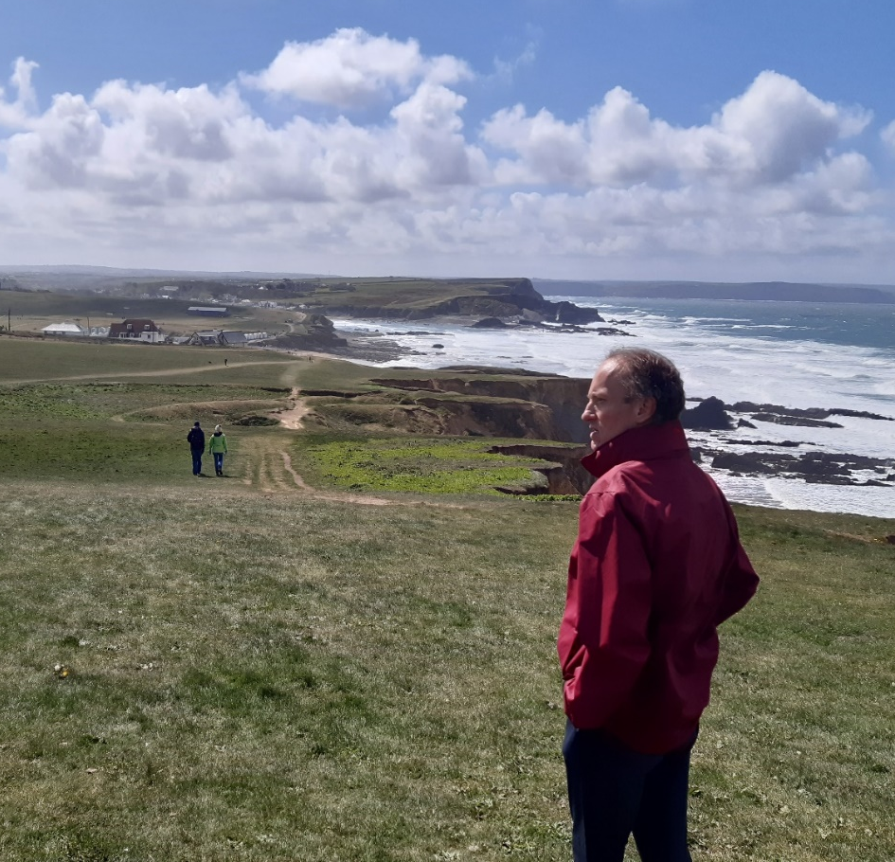
Success Story
M connected with VW in Summer 2020
During lockdown he engaged online
He joined Naomi & Nats Natter
Brushed up his CV and Interview techniques
Took courses around disability & managing his money
Joined the walking group
Is booked on the surfing event
He got a laptop & rugs to keep warm in his flat
He has got a job in the local Premier Inn and just had his contract extended
Mark’s story is a great success, he has grown from someone who was out of work, unhappy and unwell, to someone who has a job that suits him and where he is appreciated, living in a place he likes, and with plans for his future.

Slide 24
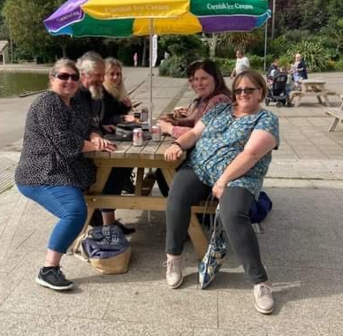
More Success
SP joined VW in May 2020, with physical and mental health issues
A wheelchair user with a bad back and ME
3 young children and a partner who stopped working to care for her
Universal Credit
Large debt
Referrals to relevant health providers (inc physios) and to CAC
Counselling sessions arranged and funded by VW
Careers Advice session from NCS
Support from Digital Inclusion – access to Audio books & other online training
Now – she is doing a mechanics course (VW have paid for course materials and PPE); her partner is looking afresh at courses and opportunities.

Slide 25
Finally
It’s been tough to achieve targets during COVID (215 out of 414 sign ups); (36/153 into work)
But:
  69/70 into Education and Training
Due to end March 2022, hoping for an extension to September 2022 so that we can achieve the targets, support customers into work and spend the budget
Working with other ESF providers to agree how we can share customers and help them achieve their best outcomes.

Slide 26

Thank you
01872 326440
inclusioncornwall@gmail.com
www.inclusioncornwall.co.uk
@inclusioncnwall
Notes:
Jennie to talk though Topic based resource sheets.
Ellie reinforce Hub help and links made in room.

