Slide 1
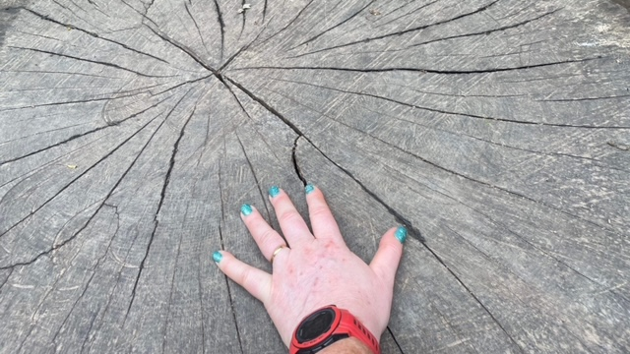
Andrea Gilbert
IC Board Member and Private Sector

Slide 2
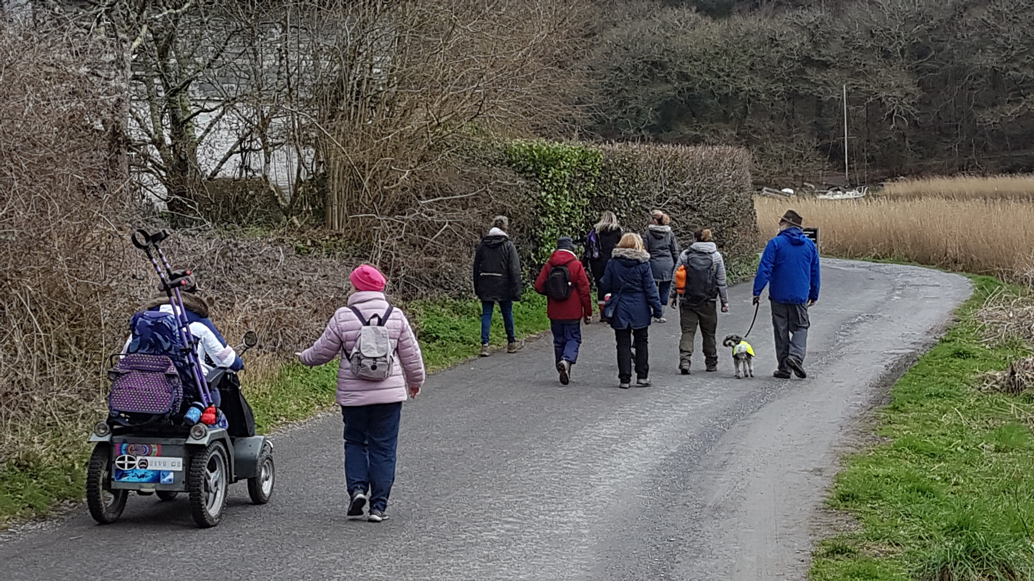
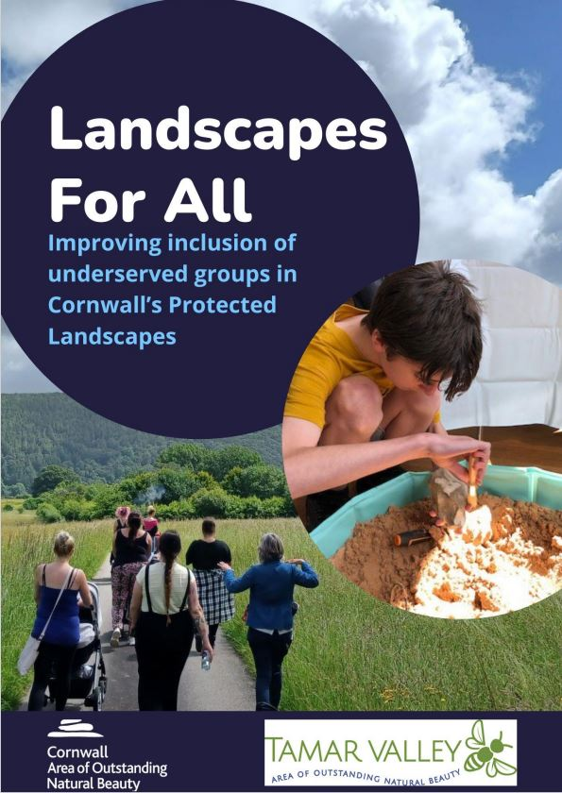
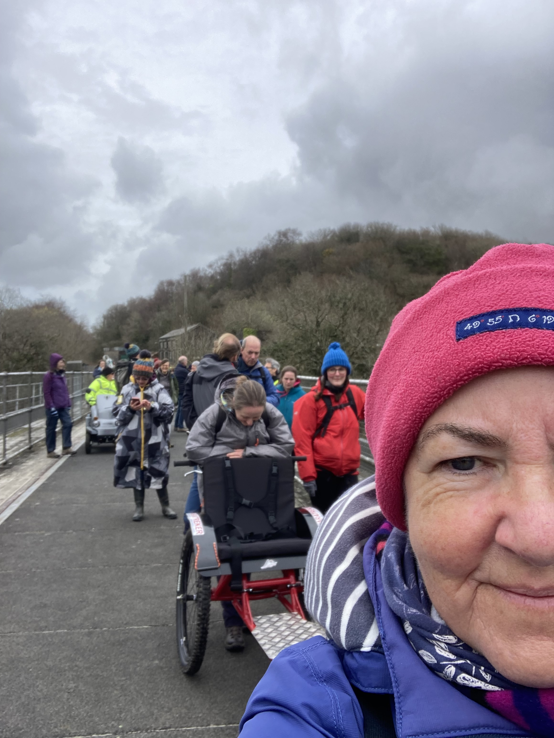
Inclusion Cornwall has recently been working with Cornwall and Tamar Valley AONB’s.
Both organisations are committed to supporting people get out into our green and open spaces.
To find out more of what we have achieved so far Environmental Inclusion (inclusioncornwall.co.uk)
Notes:
We both recognize The Natural Environment is a Primary Determinant for our health
And Equality Act Impact

Slide 3
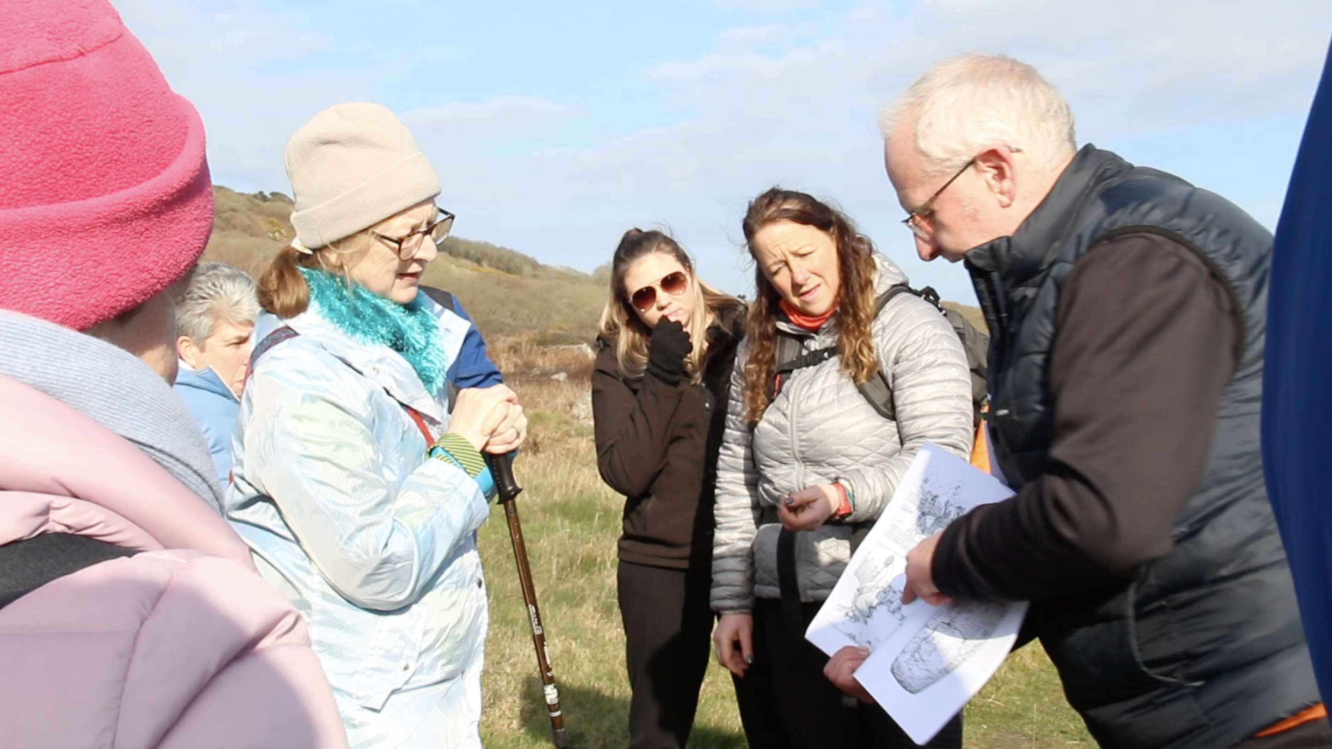
“It doesn’t matter who you are, or what your ability is or what background you’re from or what your circumstances are, everyone should have a right to access green and open spaces”
Cornwall and Tamar Valley AONB
Notes:
The statistics show certain groups are especially disconnected.
Most visits are made by the same (better off, less diverse) people repeatedly, and those who miss out are:-
Older people,
the young, ▪ especially adolescents and those from lower socioeconomic groups •
Black, Asian and minority ethnic communities ▪
Children are spending less time unsupervised outside and
children from black, Asian and minority ethnic, and low income, communities are even less likely to do so.
18% of children living in the most deprived areas never visit the

Slide 4
AIM
Inspire others to spend more time in nature
01
Give ‘gifts’ of mindful moments
02
Encourage people to see nature through new eyes
03
Help individuals to ‘remember’ how to be playful and curious
04
Potentially have a positive impact on physical and mental health
05
Notes:
Inspire
Minfulness
See nature differently – we realised we wanted to get out in all kinds of weather
Impact on physical and mental health
A mounting body of evidence tends to show that, at a population level, higher levels of exposure to natural environments are associated with lower all-cause mortality, rates of type 2 diabetes, cardiovascular and respiratory disease, and more positive perinatal outcomes. Less is known about relationships with cancer, musculoskeletal health, allergies, or of the impact of different types of environments.

Slide 5
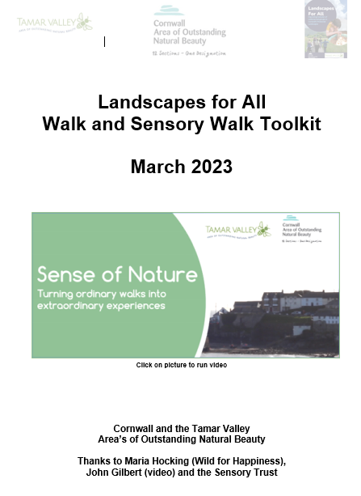
A Toolkit for All
Notes:
We have published a Toolkit so you can all plan your own sensory walks – small – easy walks. Our residents will see access to the open and green spaces could be the key to removing other barriers in their lives

Slide 6
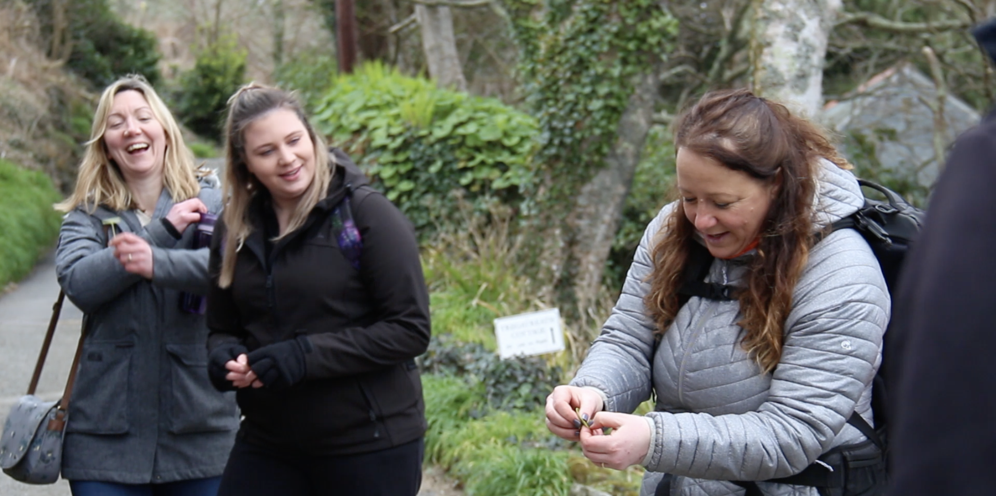
Notes:
Getting out

Slide 7
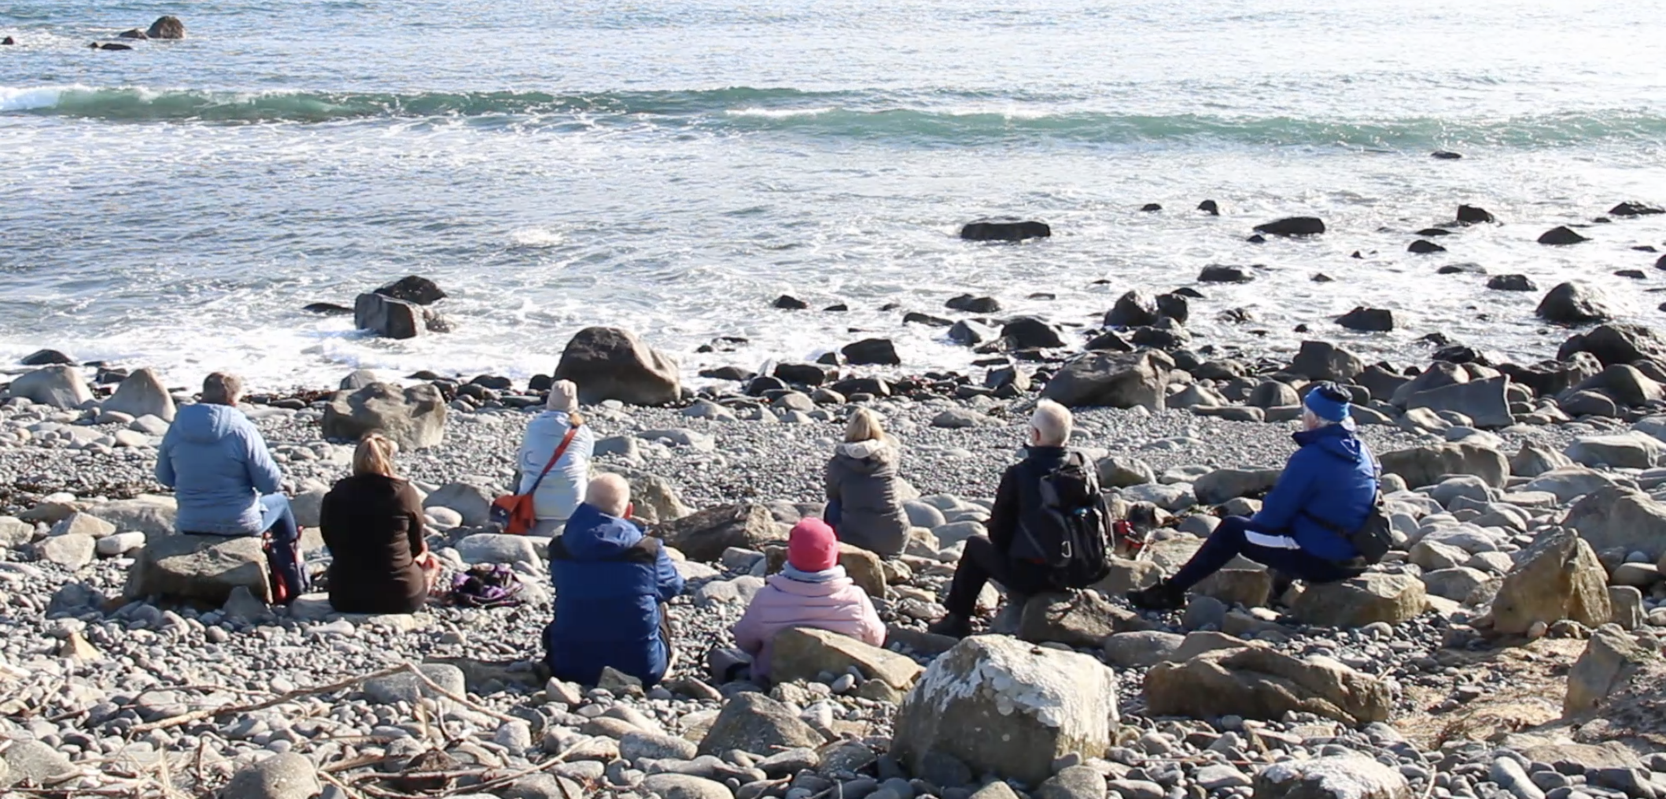
Notes:
To sit and listen – we all felt ourselves to be calmer
The change was so significant
BUT – how to we gt people to take up these opportunities???

Slide 8
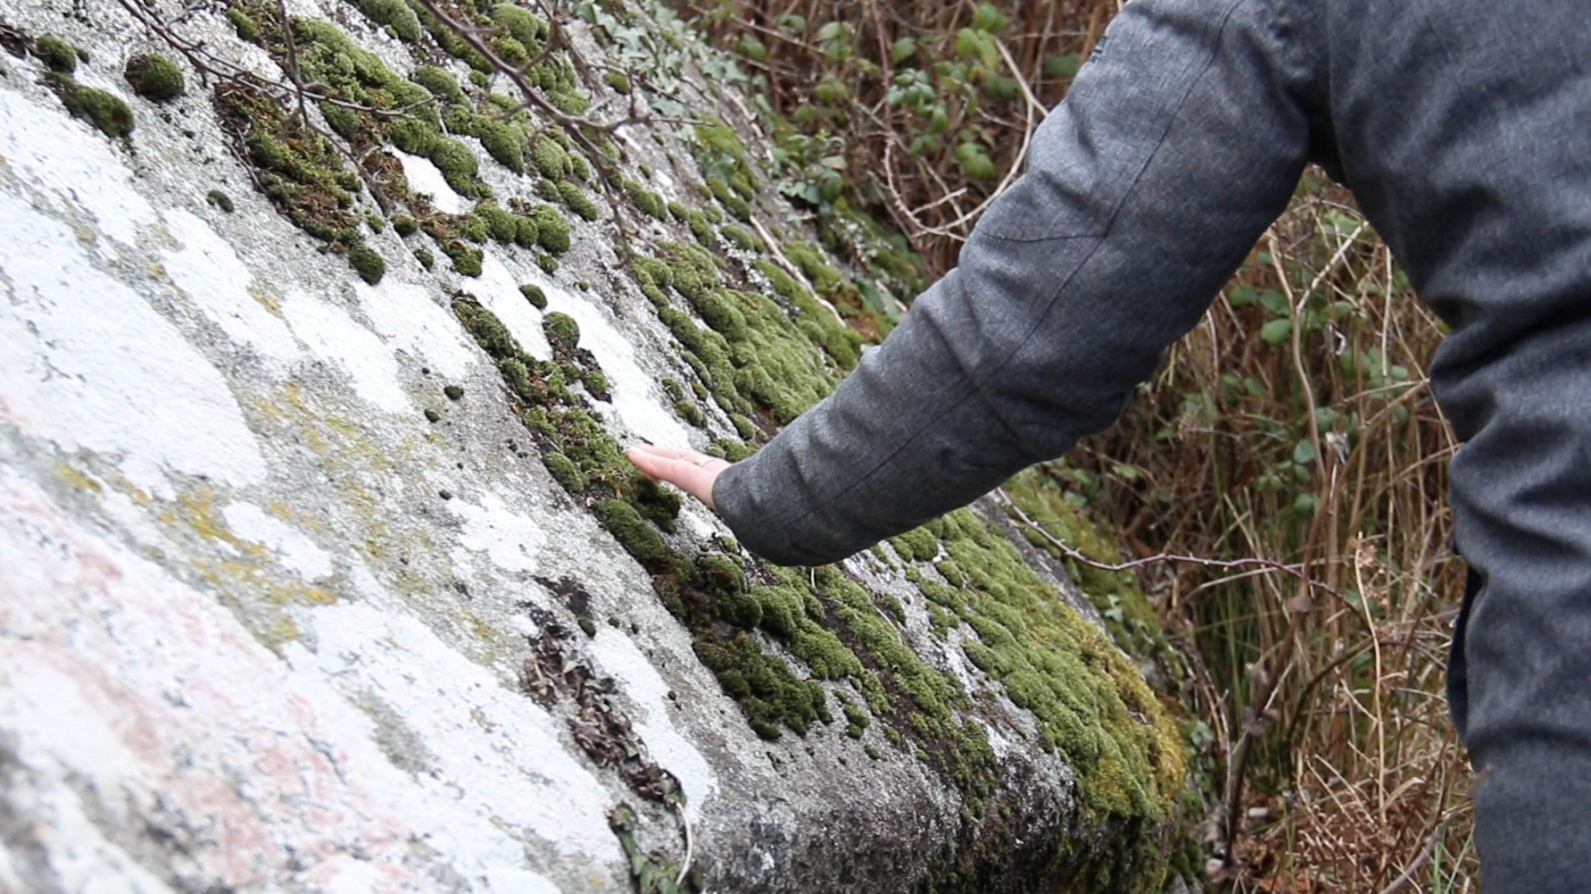
Notes:
Touch – made us consider what was around us in a different way

Slide 9
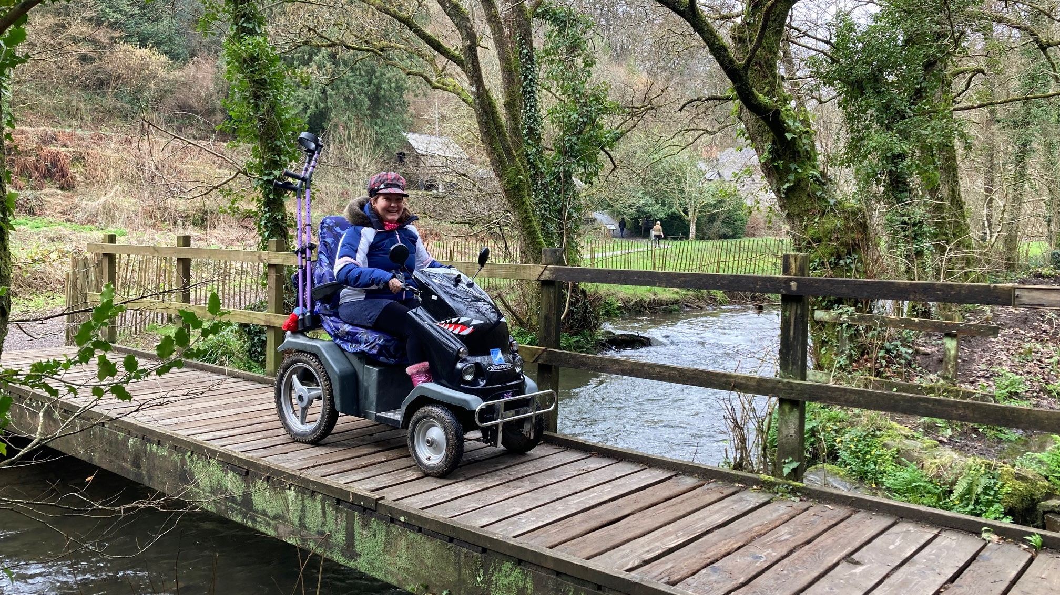
Notes:
Our landscapes must also make strides to make areas more accessible for disabled visitors. Poorly designed countryside infrastructure can needlessly make it hard for them or stop them visiting at all.
1 in 10 need a mobility scooter – standards need to be the same so users know what to expect from paths - a simple ask could make a huge difference to access

Slide 10
Future Walks – Share and book
call Maria on 07922 046740
2 Oct. 2023
Ladock, 10am to 1pm
15 Nov. 2023
Namphillows and Trelissick, 10am to 1.30pm
7 Feb. 2024
Cothele, 10am – 12.15pm
6 Mar. 2024
St. Nectans Glen, 10am – 1pm
15 Apr. 2024
Cothele Volksmarching, 11am – 2pm.
13 May 2024
St. Just, 1pm to 4pm
20 May 2024
Coverack 10am – 1.30pm
3 June 2024
Ladock, Volksmarching, 11am – 2pm.
Notes:
Help us fill the walks

Slide 11
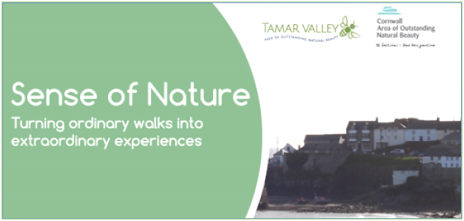
Notes:
As time is short and we cannot take you on a walk – we have the next best option. Please sit back and take this walk with us virtually – it is the next best thing.

