Slide 1

Notes:
Bev welcome

Slide 2
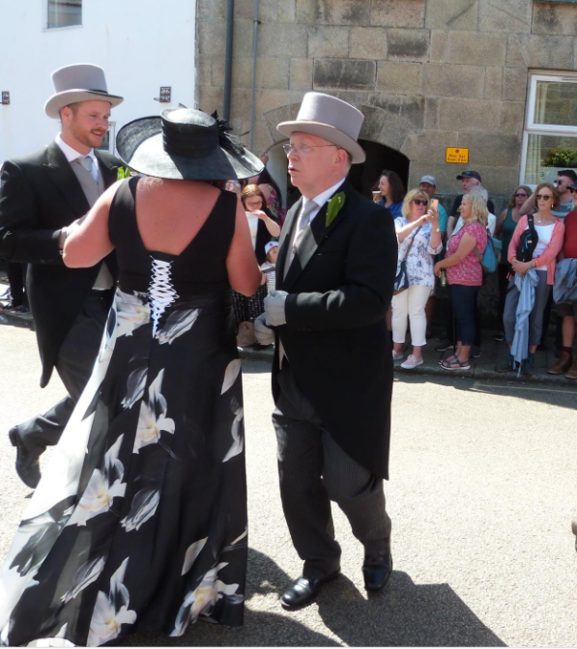
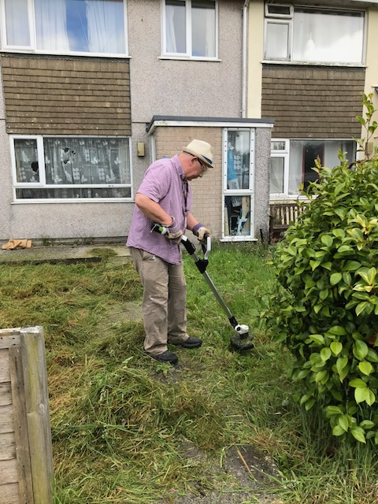
Honorary
Chair
Notes:
Bev - Thank you to Cllr Mike Thomas for being a hands on Chair who challenges and supports us.

Slide 3
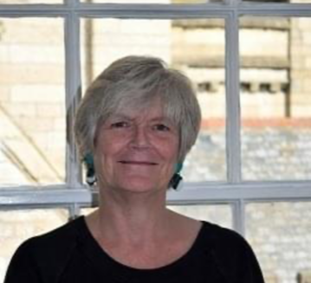
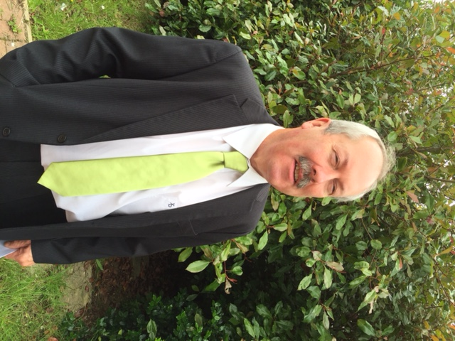
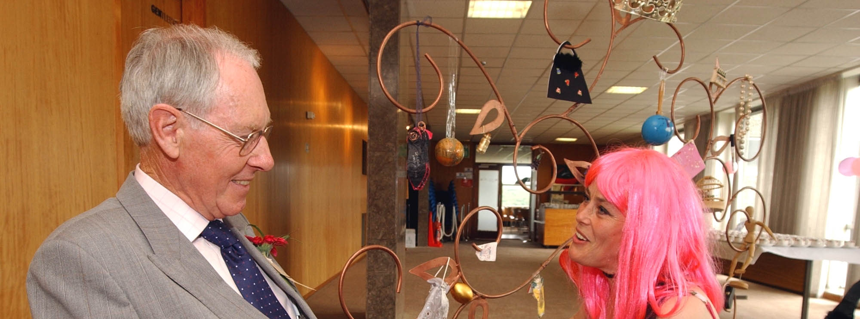
David
John
Carolyn
Notes:
As we enter our 20th Year we should remember our previous Chair’s – Carolyn, David and John – Thank you to all of them

Slide 4
We Will Cover Today
20 Years!!!
We didn’t expect to still be here
The past 12 months
Your Input
The Future
Notes:
Bev - Today we will cover a quick look at 20 year! We are shocked to still be here to still be NEEDED, we wanted to work our way out of being required within 5 years. We will look at the last 12 months what we have been up to and to ask you to take part in considering how we challenge Cornwall going forward.

Slide 5

2
We enter a Special Celebration year
Notes:
Lisa -- > We are entering our 20th Year we want to celebrate and challenge

Slide 6
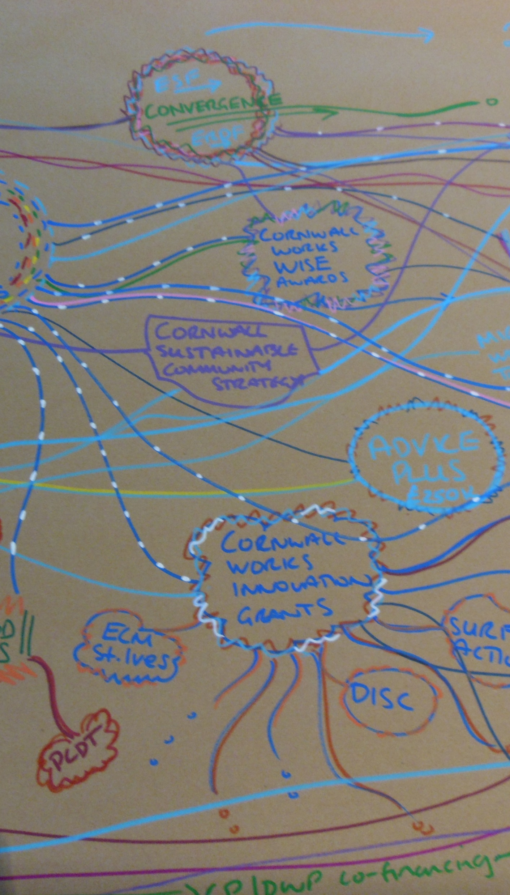
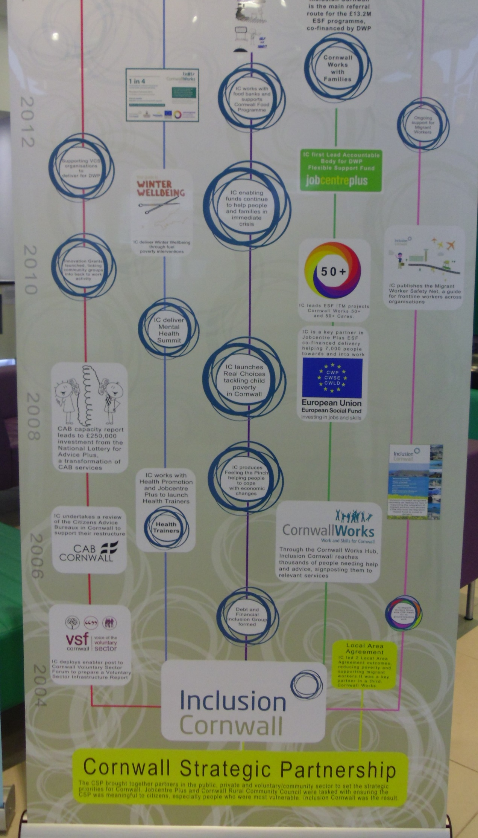
We will Update
The First
ten years
Notes:
Lisa -- > AS we have been around for 20 years we will update our achievements and many will be surprised to see what we have been involved with over the years.

Slide 7
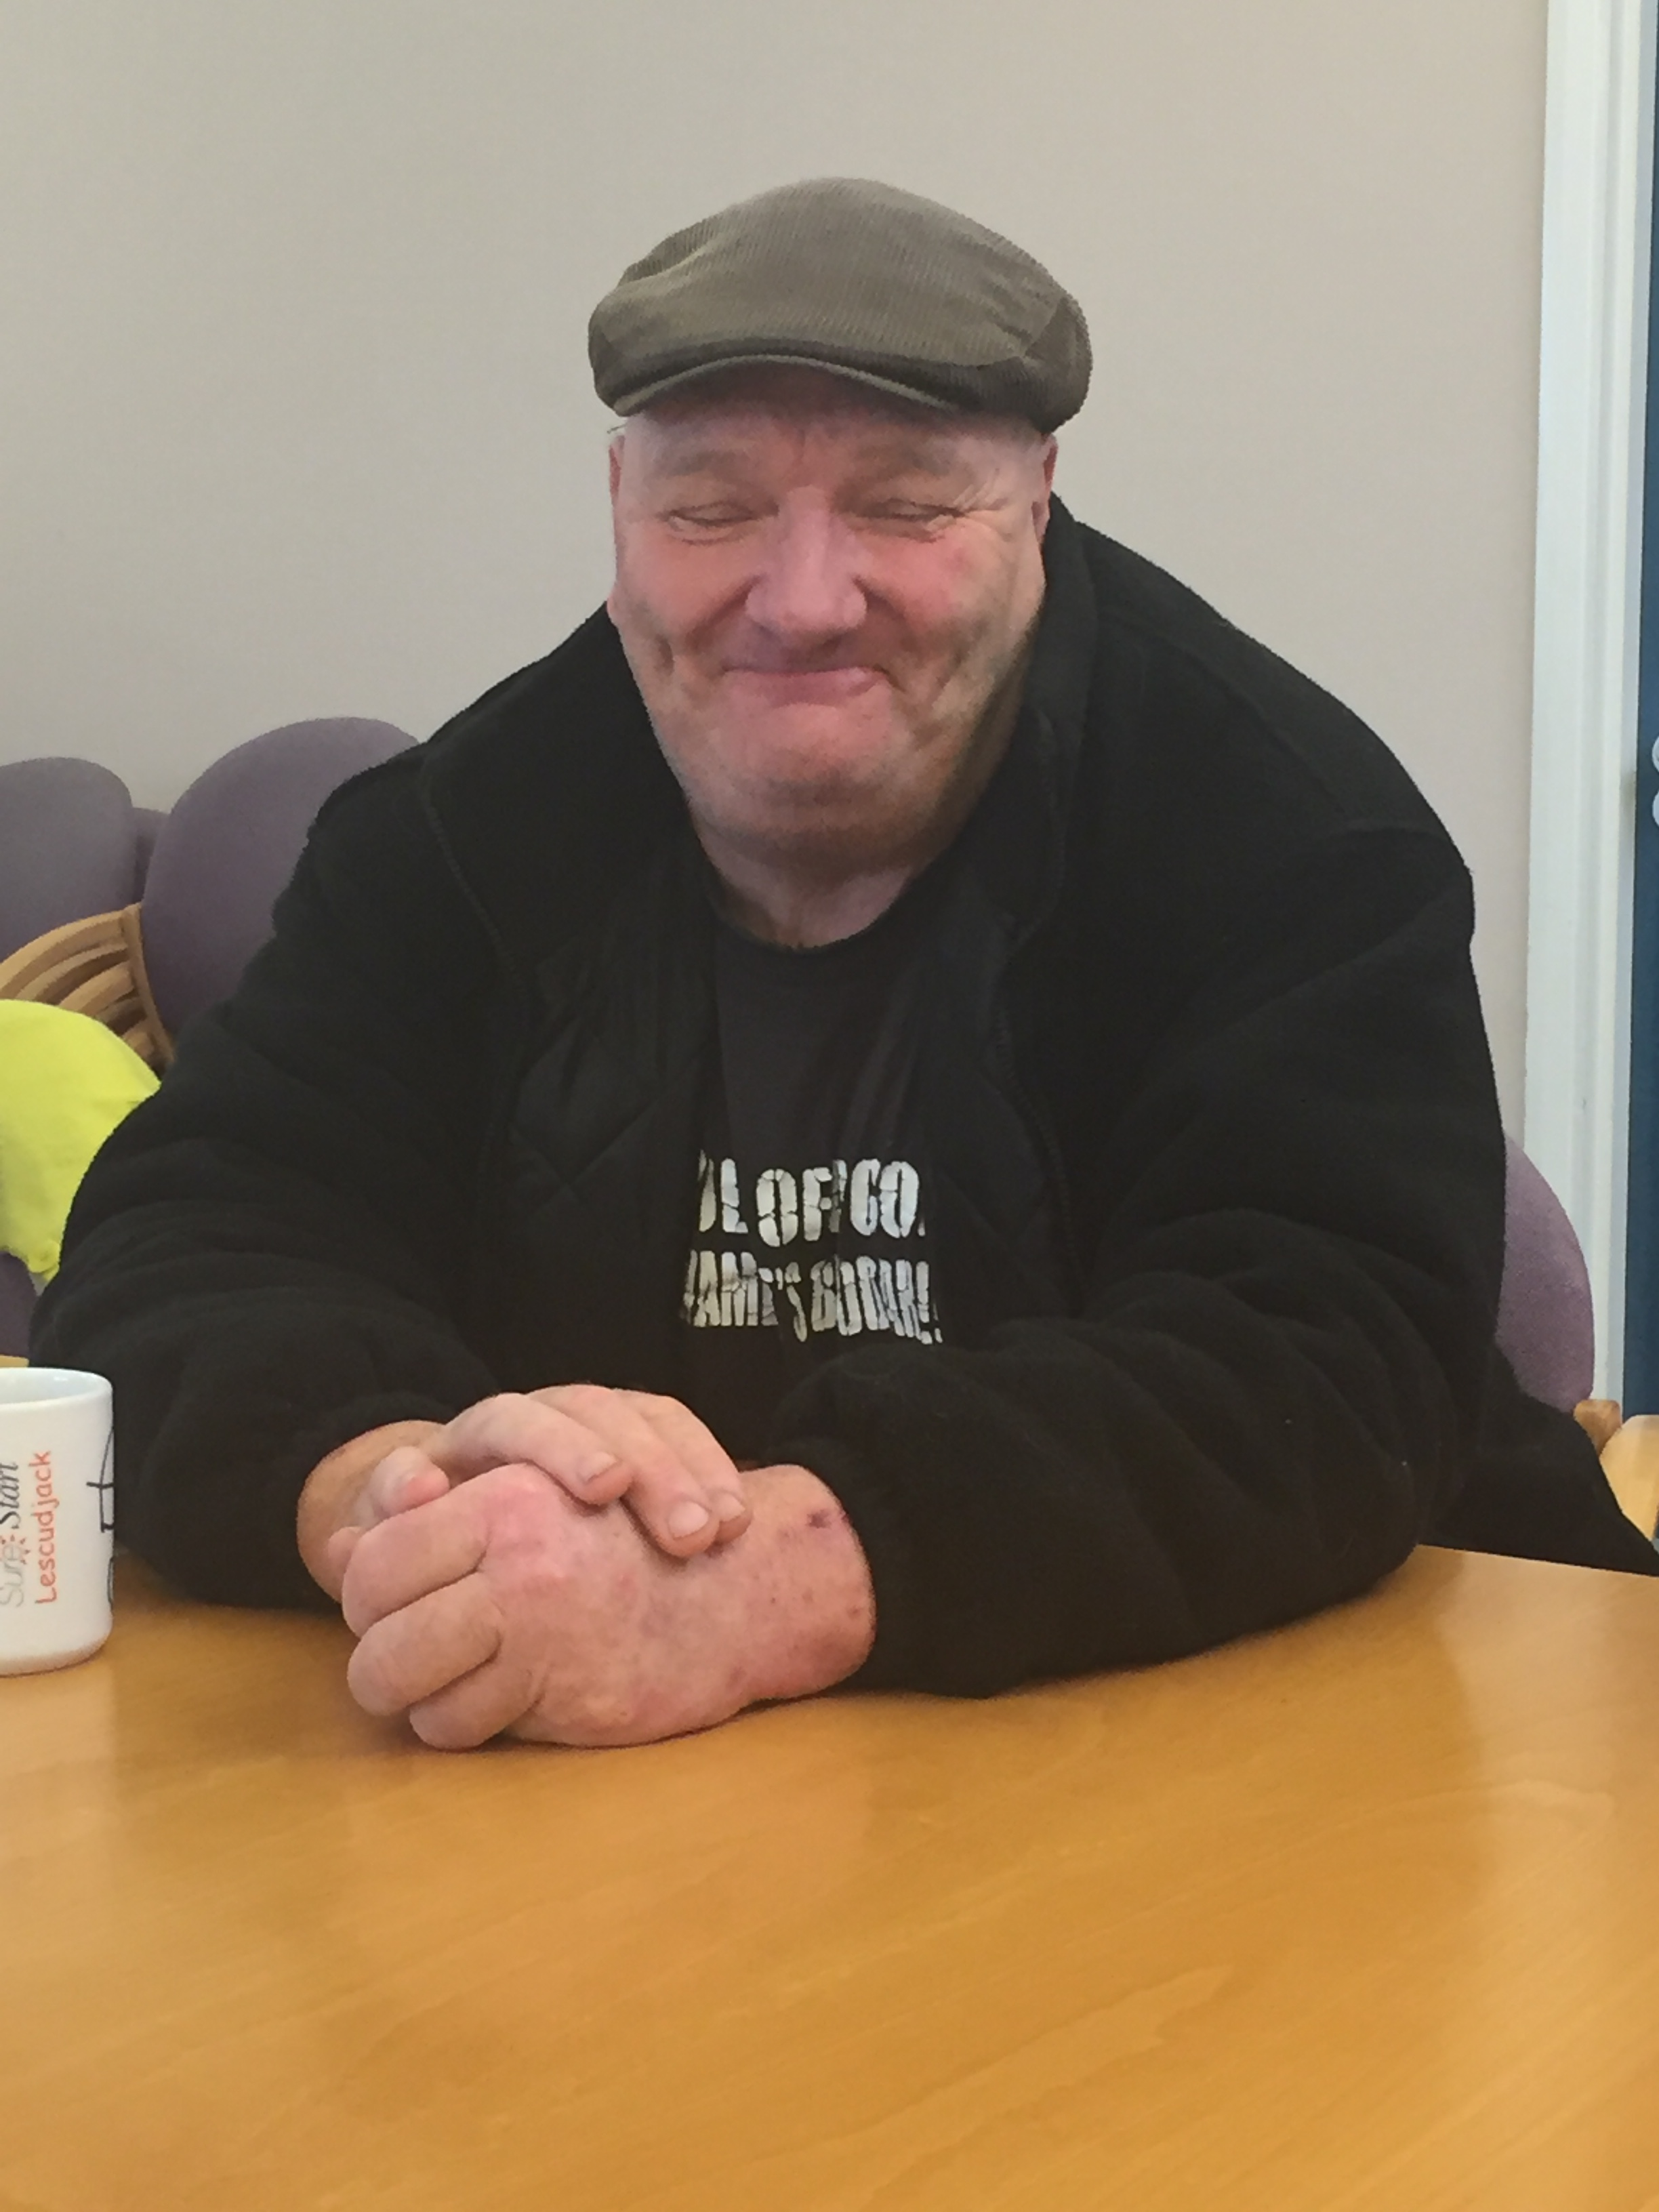
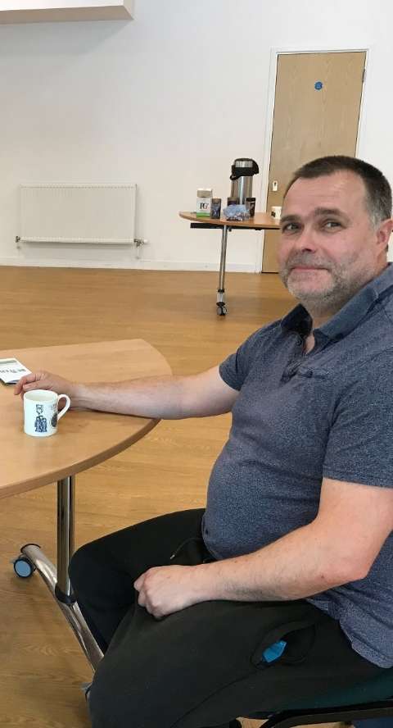
Notes:
Lisa - Our Customers are always our focus, our reason to challenge/support/encourage and train our partners

Slide 8
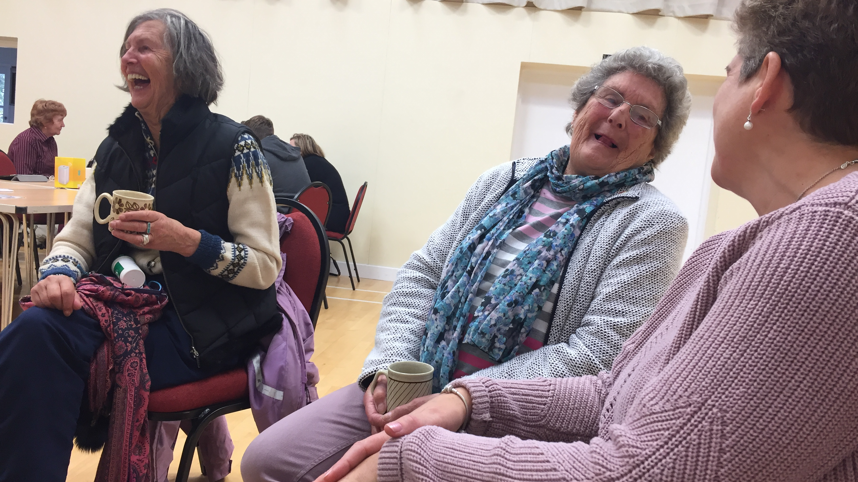
Notes:
Lisa - Our ageing population as we live longer – we want them to have a higher quality of life managing multiple conditions.

Slide 9
Does Inclusion Cornwall remain relevant and needed in Cornwall ?
Answer:- Unanimous agreement certainly
Does Inclusion Cornwall need a stronger strategic focus regaining its former position strategically
Answer:- Unanimous agreement certainly
In 2023 we asked the
IC Steering Group
Notes:
Bev – So with this backdrop we wanted to take stock of our position and we asked the Steering Group for direction.
Do we remain relevant and the answer was YES.
Do we need to be stronger and the answer was YES

Slide 10

Do we still agree?
We want: A Thriving Cornwall with Equal Opportunity
We will: Challenge Inequality, Join Up Services, Celebrate Difference and Assist Residents, Communities and Services to Achieve Better Outcomes.
Notes:
Andrew - So we have stamped our aims – what we want is a thriving Cornwall with equal opportunities to work, health, training. AND so we will challenge, and do what we have always done – we will join up services, assist residents and communities to better outcomes

Slide 11

Inclusion Cornwall's strategic role places it at the forefront of addressing social, economic and environmental inclusion themes in Cornwall.
We work alongside hundreds of stakeholders, including local authorities, private sector, charities, and community groups, to identify and address the key social, economic and environmental issues that affect the County.
Notes:
Andrew – We will retain our strategic role addressing Social economic and environmental themes. We will continue to work alongside hundreds of partners across sectors. We will retain a unique impartial challenge. Guiding with resource sheets and information that is up to date every week.

Slide 12

Remain a Cross Sector Partnership – hosted by Cornwall Council.
Challenge with diplomacy, where services do not help people.
Are pro-active and re-active to inclusion issues but never duplicate.
Champion links between work and health.
Work with Customers and Partners when they do not know where to turn.
Secured over £40 million in Grant Funding for Cornwall since 2004.
Agile
Advice
Audacious
In our work
Notes:
Bev - We will remain pro-active, looking ahead, never duplicating. Work has always been our focus supporting those towards and into work but also those who are suffering in-work poverty.

Slide 13
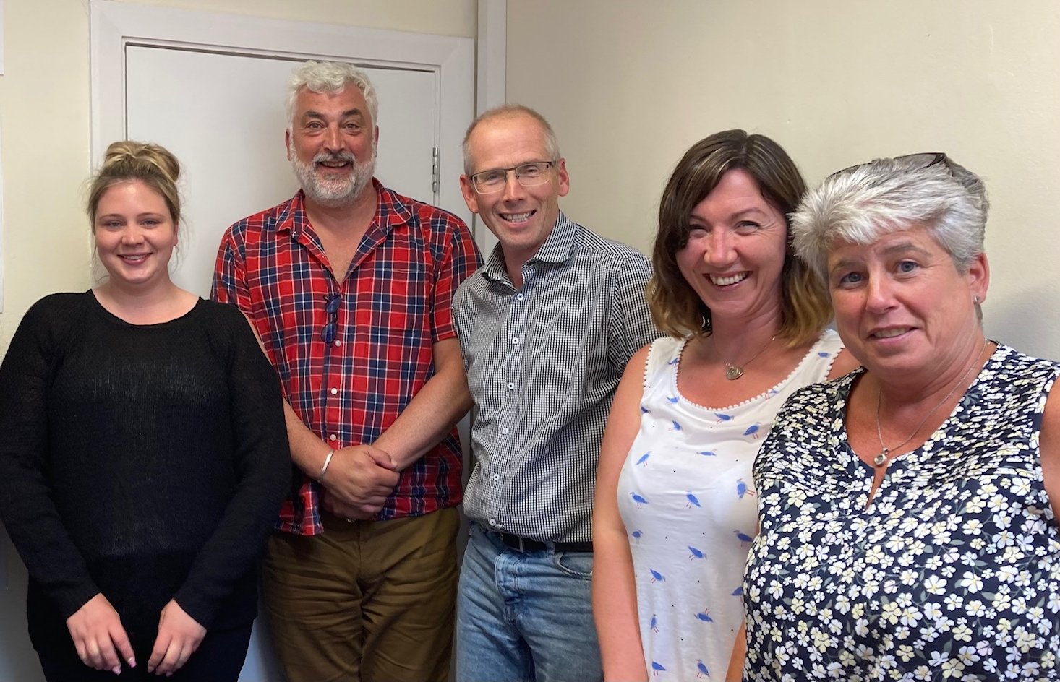
Notes:
Bev – and here is The Core Team

Slide 14
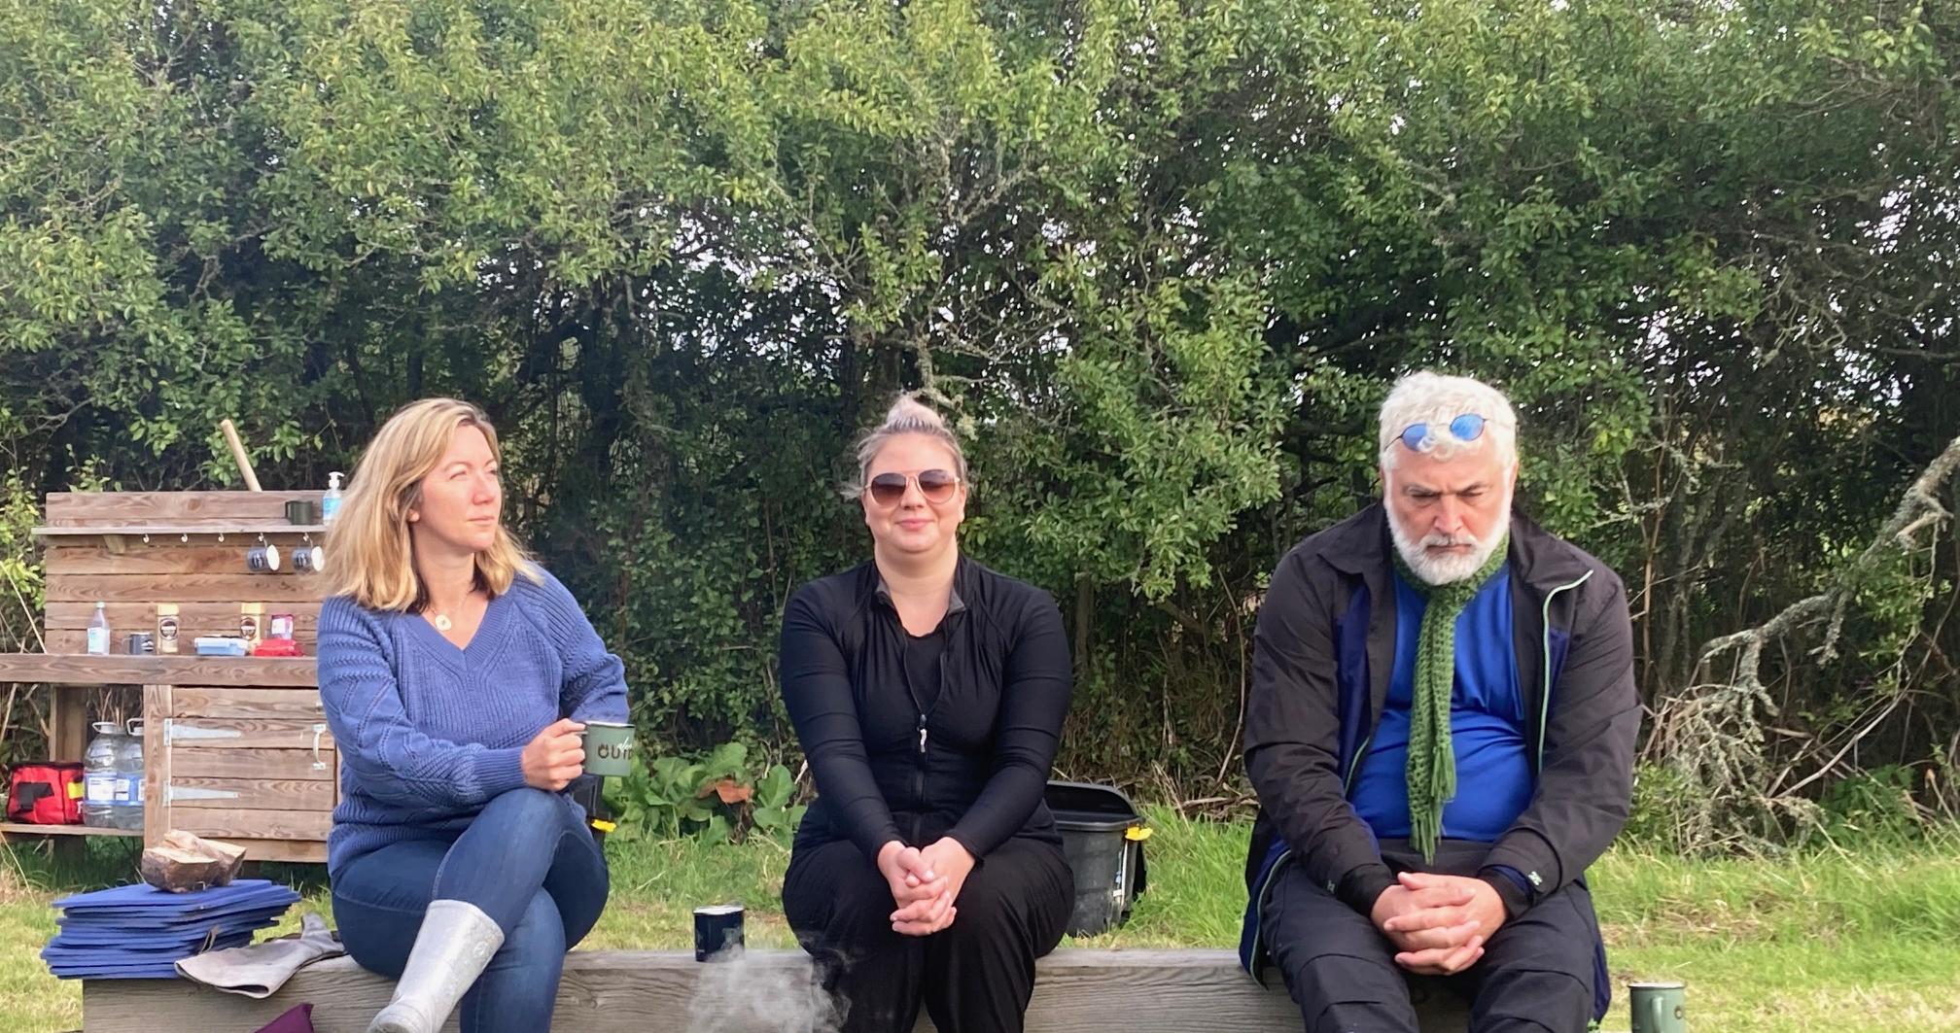
Covering all bases?
Notes:
Bev – We loved this photo = > So the team took alook back at the 20 years so far

Slide 15

20 Years for Who
2
Notes:
Bev – so we have to consider how we have supported and challenged over the past 20 years – For Who? Lets Start with our partners

Slide 16
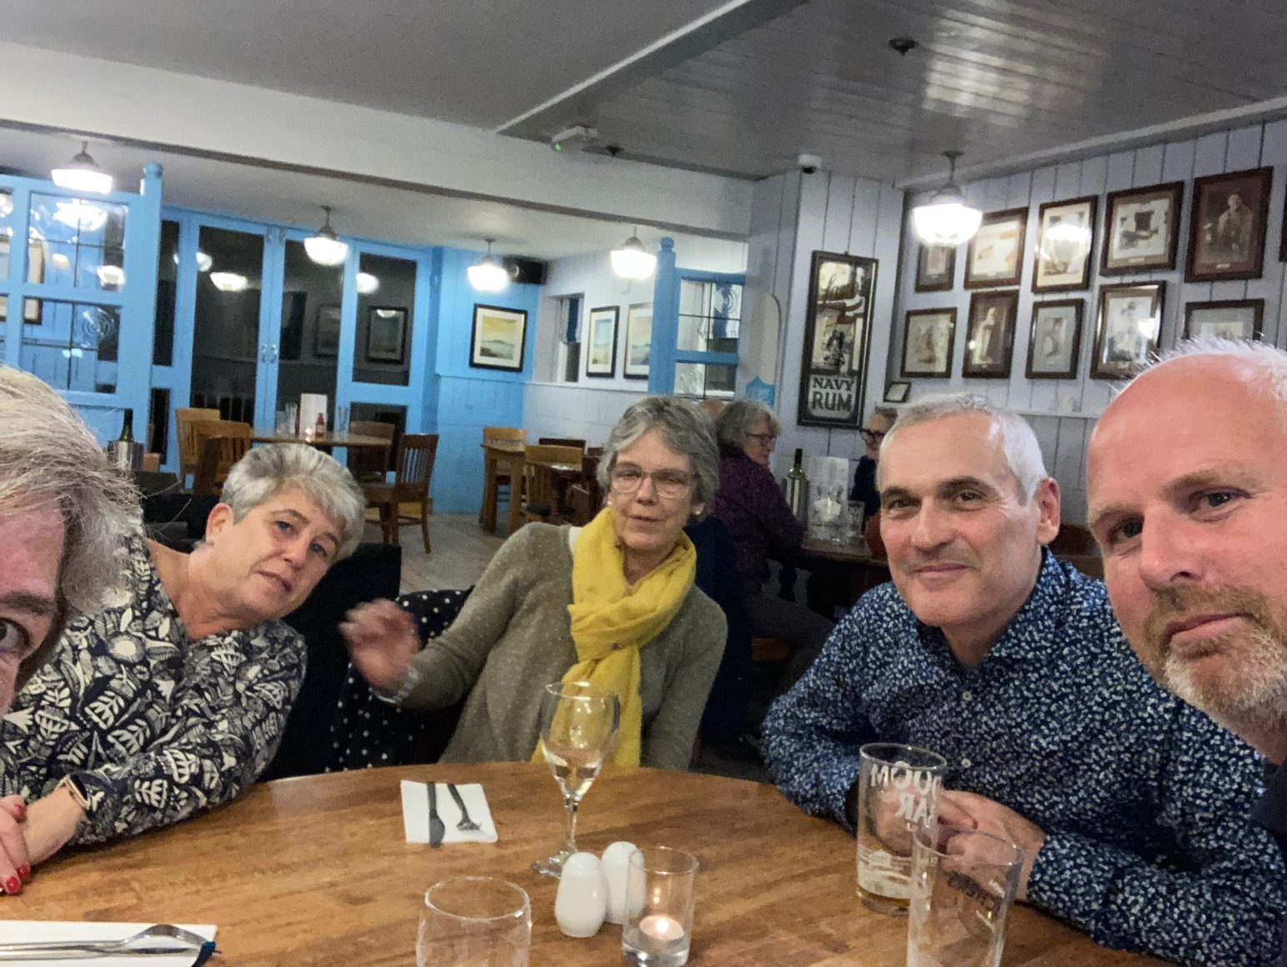
Partnership
Notes:
Bev - We have visited the Islands of Scilly for over 10 years – first working to look at child poverty but more recently focusing on Winter Wellbeing and we will hear for Joel later who is our Man of the Scillies.

Slide 17
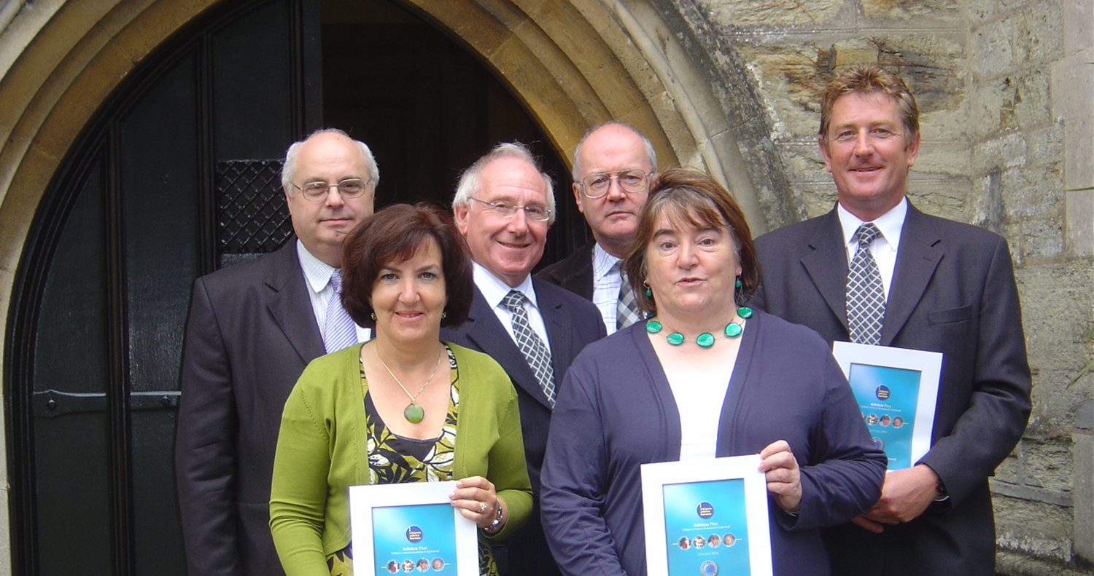
Notes:
Bev - We helped the CAB in Cornwall come together as one organization in 2005 rather than several bureaus

Slide 18
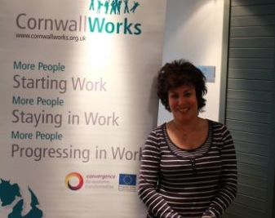
We worked with
Ruby Wax
to understand mental wellbeing
Notes:
Bev – Working with Ruby Wax we highlighted mental wellbeing – and shared our work in Sweden, Germany, France and Poland

Slide 19
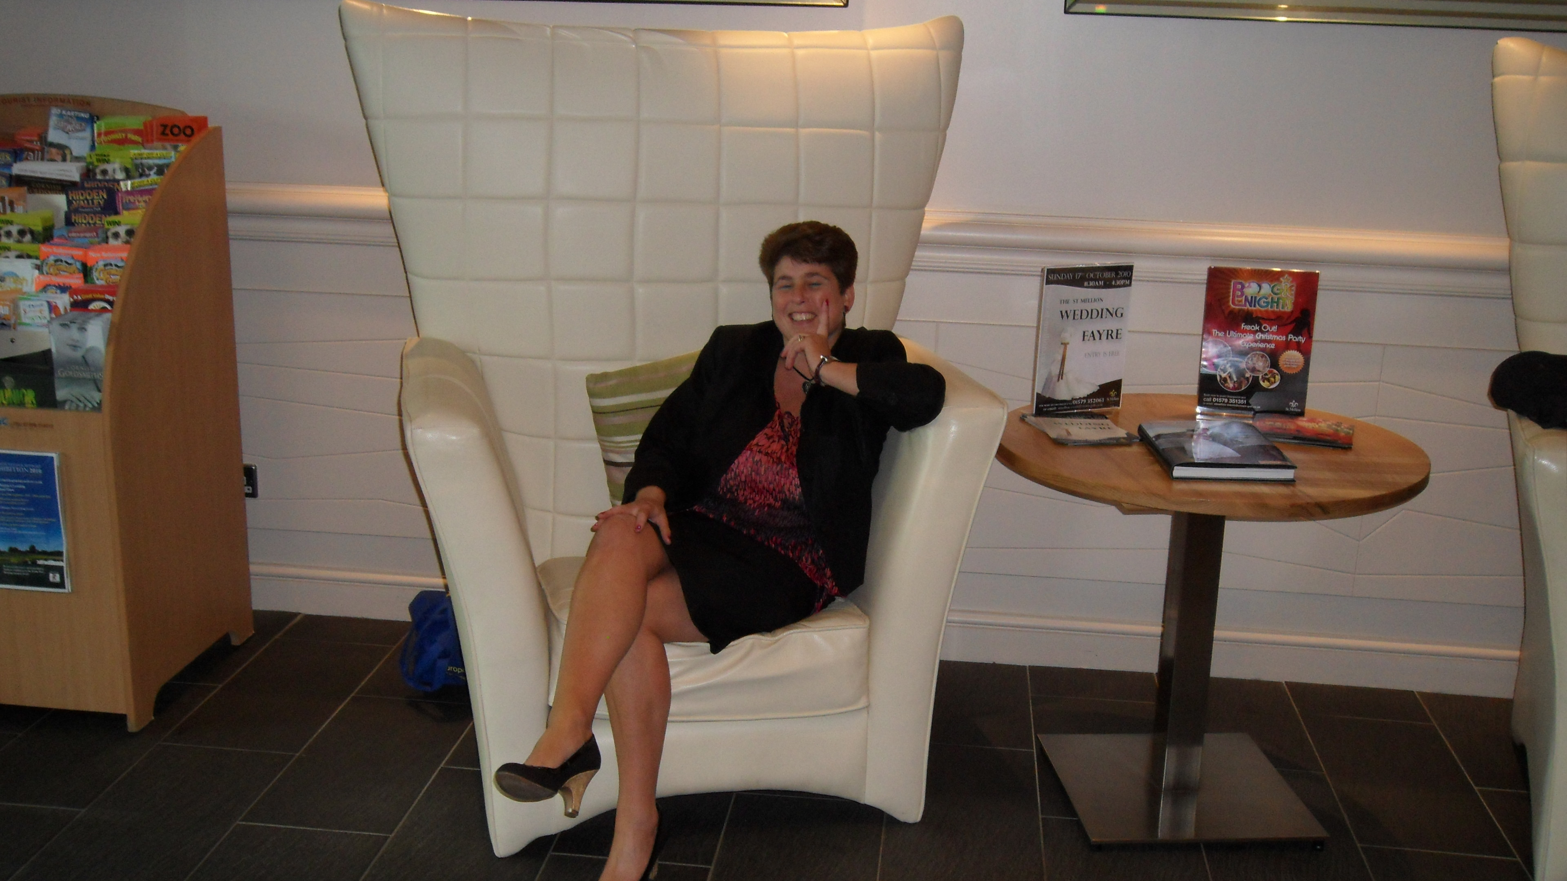
Notes:
The Ruby Wax conference was a tough one but we kept smiling

Slide 20
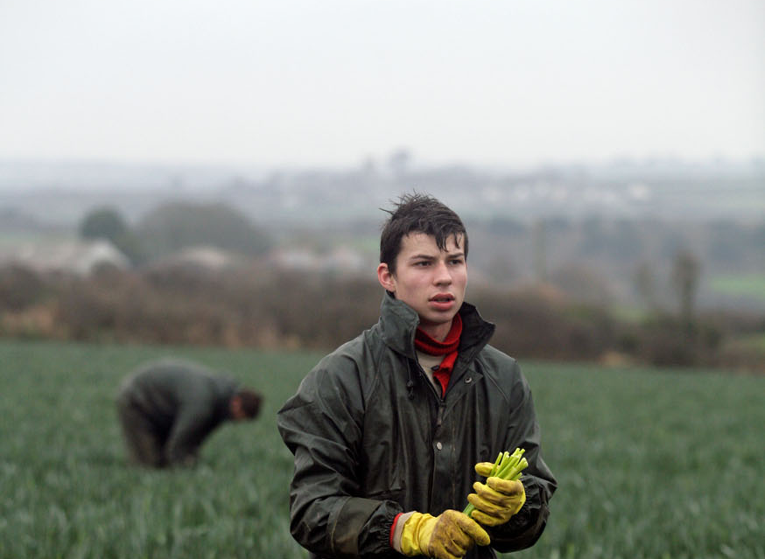
Notes:
Bev – Some will remember our Migrant Workers Welcome Pack back in 2005 – written languages – this was acclaimed Nationally as driving the work to keep our migrant workers not only safe but welcomed

Slide 21
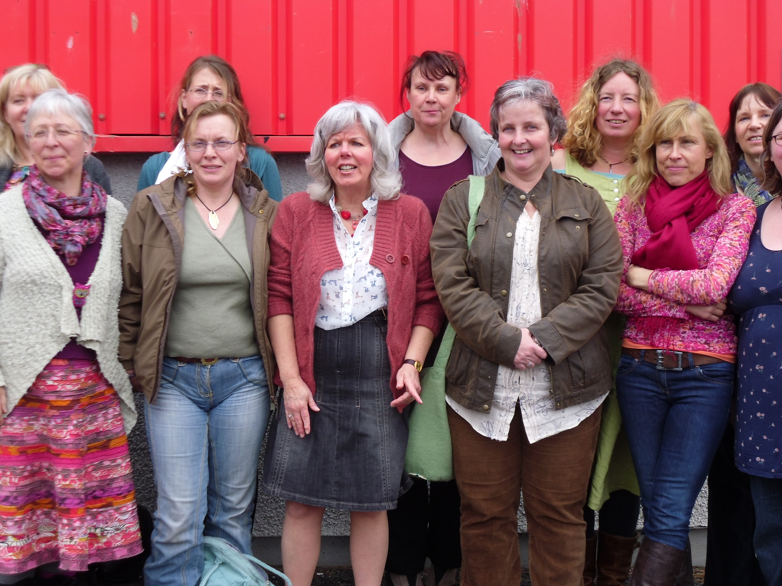
Notes:
Bev - WE raised subjects like Menopause before many others dared to raise the taboe.

Slide 22
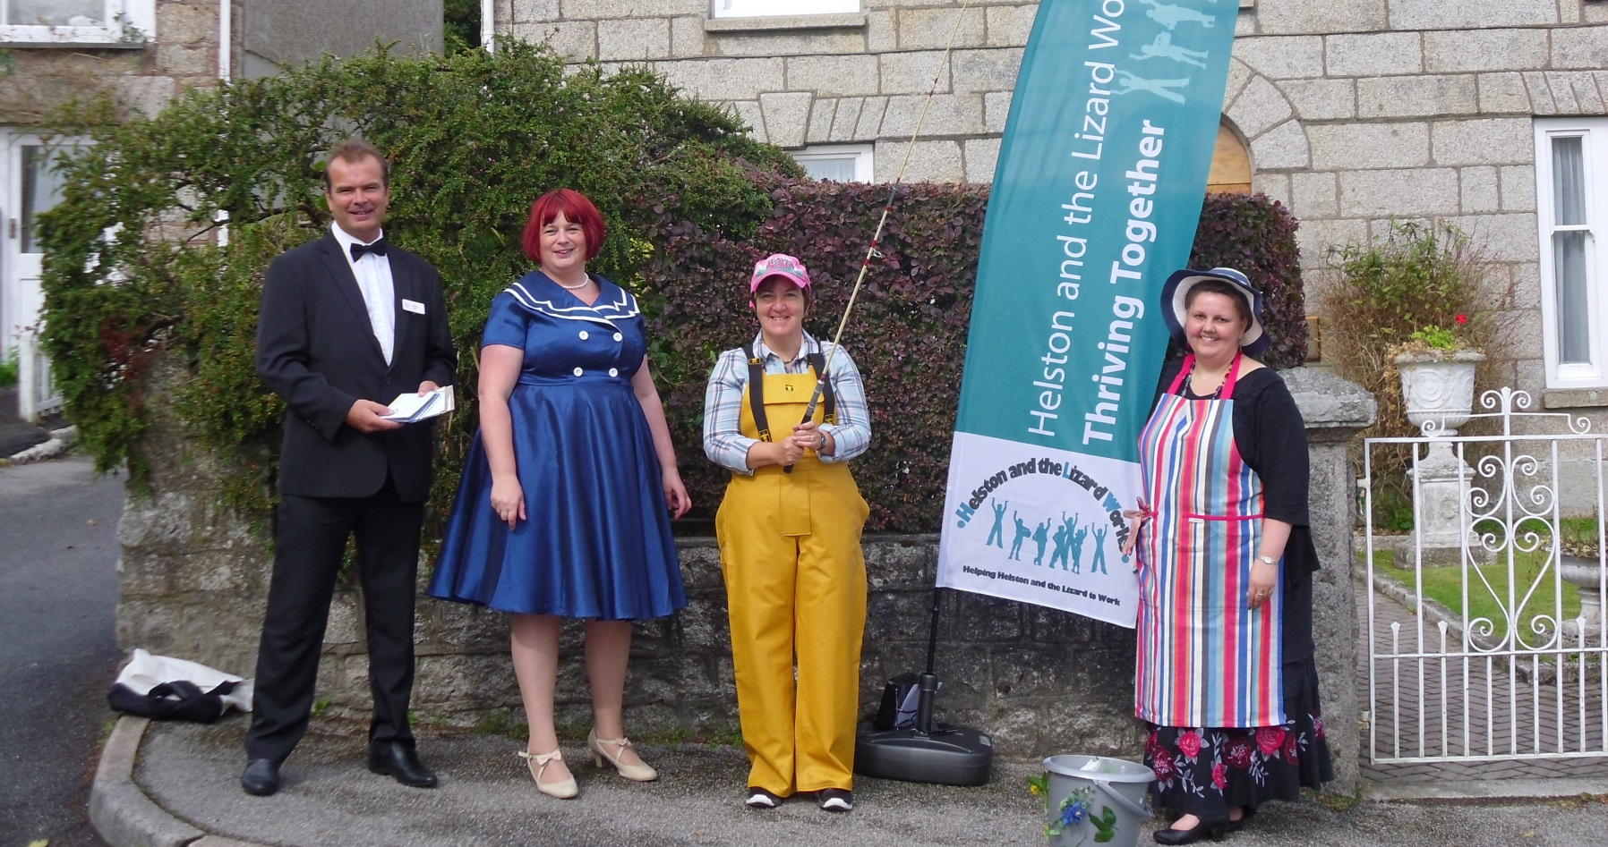
Notes:
Bev - We launched Helston and the Lizard Works - which as the forerunner of Village Works

Slide 23
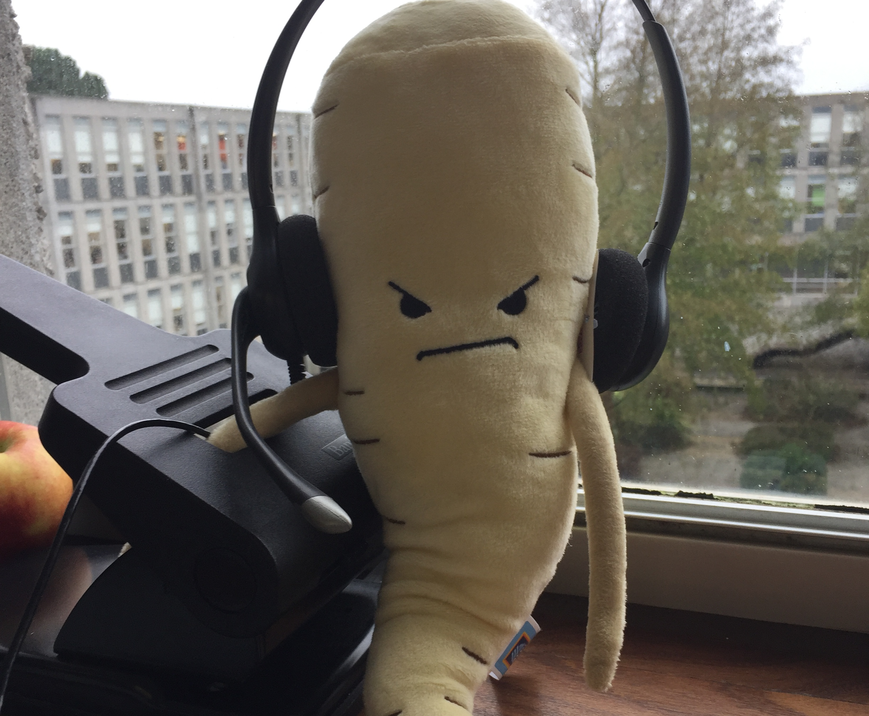

2015 we moved
into County Hall
Notes:
Sapphire in 2015 we moved into County Hall – I wasn’t with the team at the time but know they found it strange but it also had its benefits

Slide 24

Notes:
Sapphire – when in County Hall we worked closely with Social Services – we supported the County’s Social Workers which led to Inclusion Matters and we retain our links with Social Workers who regularly call us for advice and support when they don’t know where to turn

Slide 25
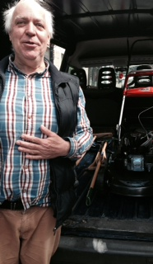
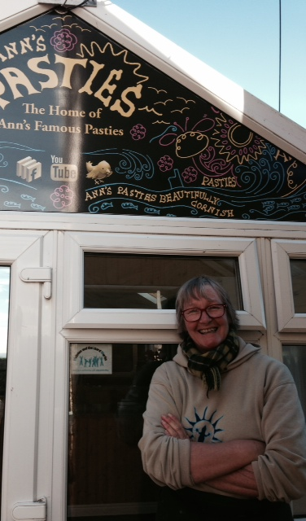
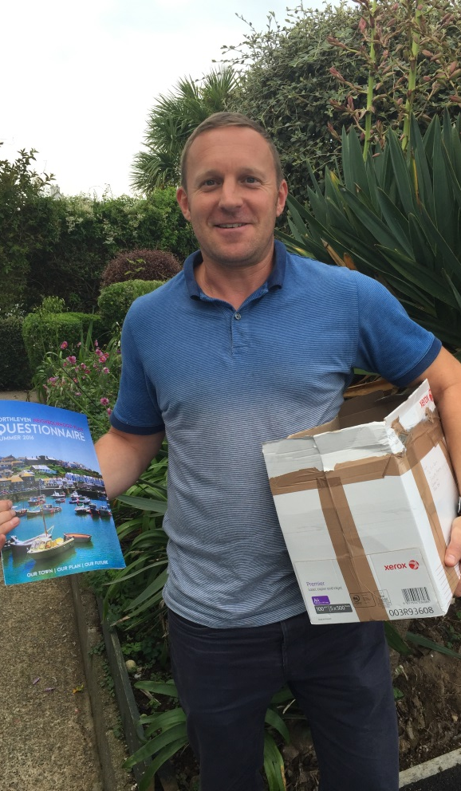
Business
Communiy
Customer
Notes:
The Village Works Project concluded on the 30 September 2022. The project began in April 2019, gained momentum in Oct 2019, and finished in Sept 2022. It helped 399 people in need, over 3 years.
Remarkably, given the challenges of Covid, almost all outcomes and targets were achieved. The final report from our evaluation provider Kovia showed that, for the £802,000 cost of the project, the benefit was valued at around £9.56m, giving a benefit of £11.92 for every £1 spent.
“The most significant effects of the project were on the customers’ confidence, self-esteem and mental health, and likely relate to the way Village Works is structured to reach the most isolated individuals.”

Slide 26
Notes:
Sapphire – this is our model of working – with individuals and families having equality of opportunity

Slide 27
Whole Person
Unique to the customer
Listen
Opportunities
Triage
Signpost
Self-responsibility
Challenge
Check up
3000 referrals a year
Hub Conversation
Notes:
Sapphire – I am the core of the Inclusion Cornwall Hub where we take referrals primarily from partners. We respond by listening, knowing what is out there and offering self-responsibility. We go further by not just supporting the partner or individual BUT also challenge and support organisations who may have not provided a top quality resolution for their customer. WE build their capacity to get it right for the next customer.

Slide 28
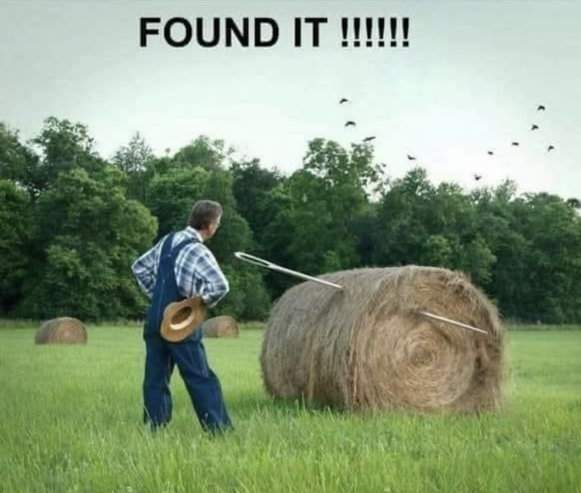
Notes:
Bev – we provide information for our partners when they don’t know where to turn

Slide 29
Guiding the Future
Collaborative and cross sector delivery solutions
Community solutions for health and work
Hand-ups rather than hand-outs
  helping people help themselves
Integrating personal rights and responsibilities
Enabling people to contribute
Early intervention and prevention
Independent and professional advice and guidance
Notes:
BEV – Cross sector delivery is critical so we do not work in SILO’s. And we have always worked on the view we provide a hand up rather than a hand out giving people the confidence to support themselves. Early intervention has been tough during Covid but we aim to go back to this driver to ensure we are looking at preventing poverty and exclusion.

Slide 30

Notes:
Bev - Over the years our work has received recognition through awards. Here at the LGC awards in 2019 we were commended

Slide 31
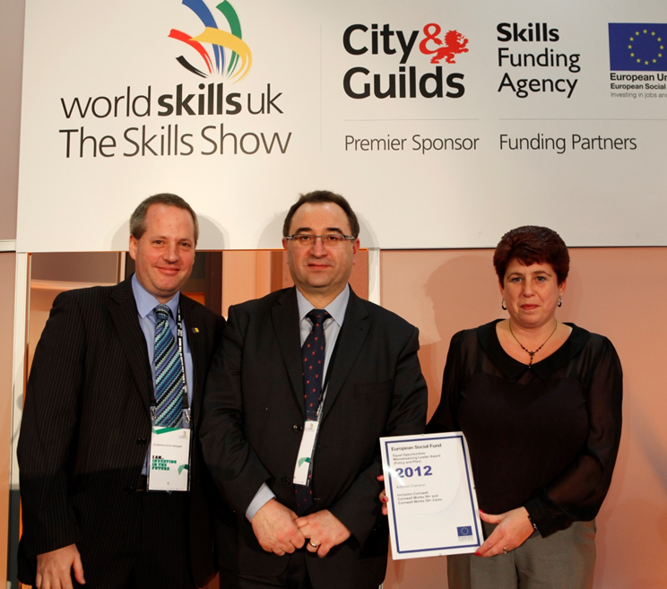
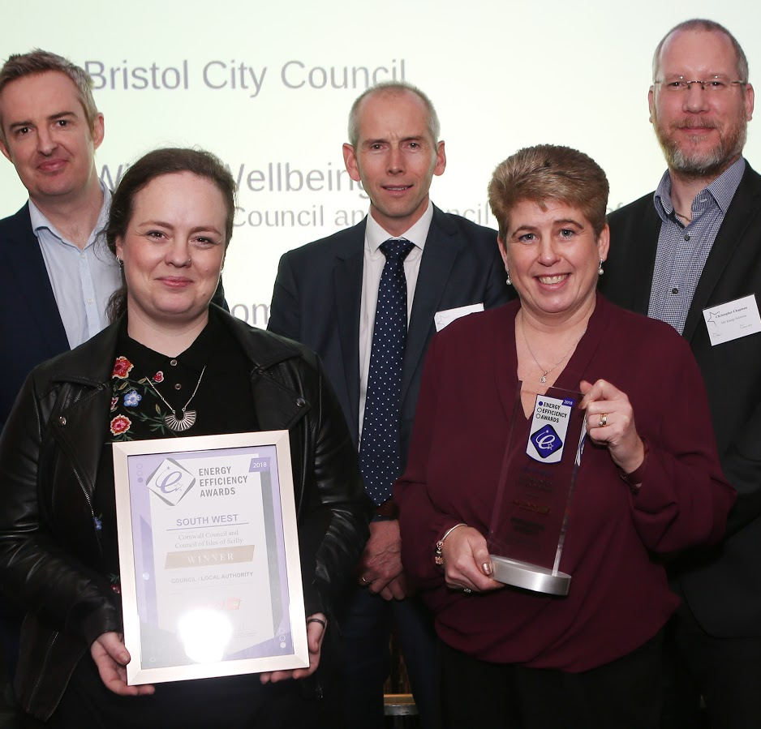
Notes:
Bev – and hear we were Winners of the Equality and Diversity Award for the Eurropean Social Fund but also for our Winter Wellbeing work

Slide 32

2024
20 Years of
Inclusion Cornwall
Let’s Celebrate
Notes:
Lisa - So we want to celebrate our 20 years of being here for Cornwall, for being a key driver for an Inclusive Cornwall

Slide 33
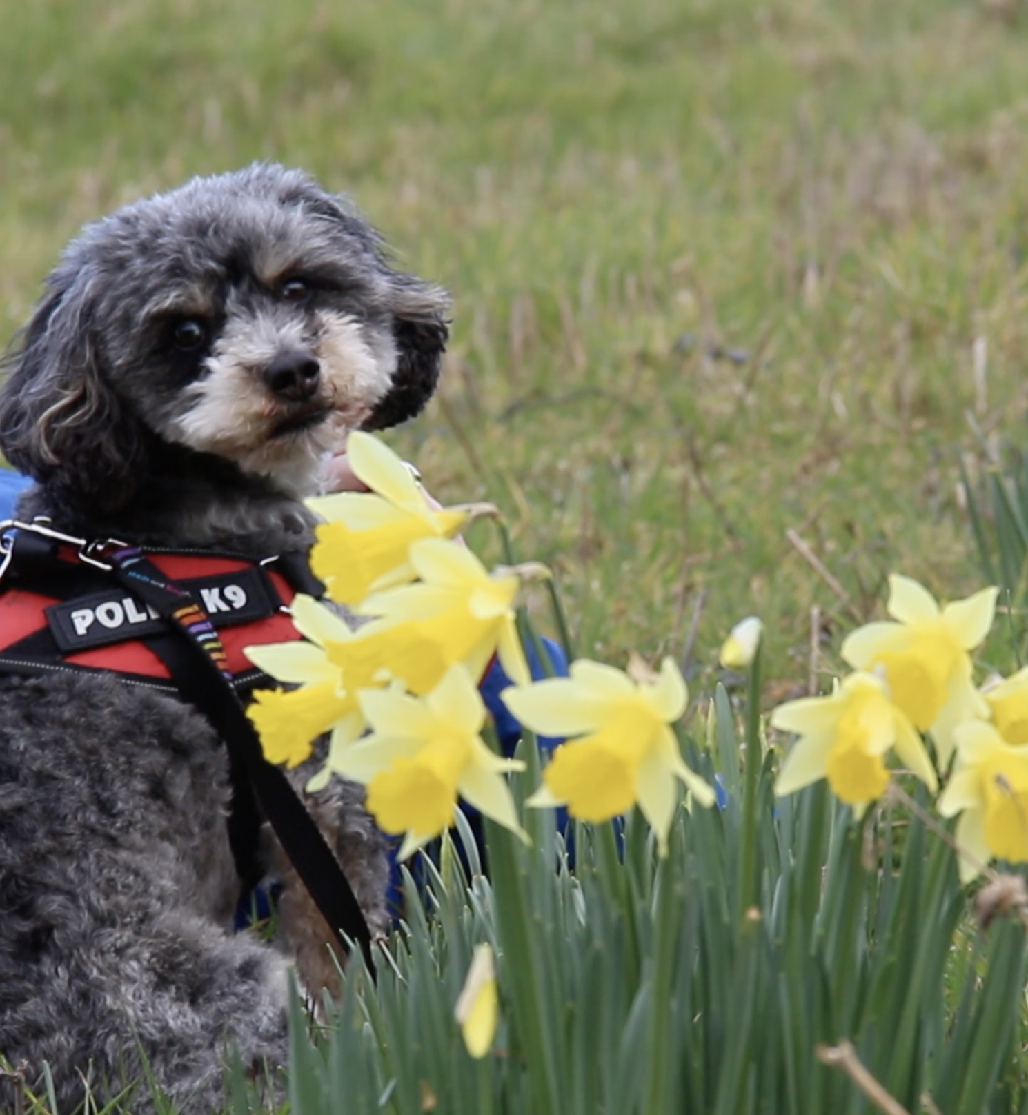
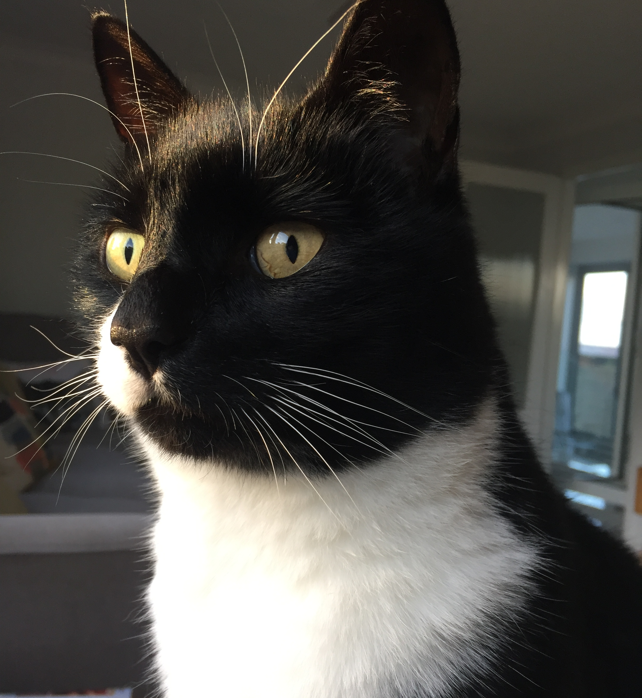
Notes:
Bev – so thank you all for coming and taking part. And I will leave you with the IC furry friends – our mascots Dexter Dog and Riley Cat.
We will now ask you to work on your tables to tell us of the key health and wellbeing issues that together we could tackle?

