Slide 1
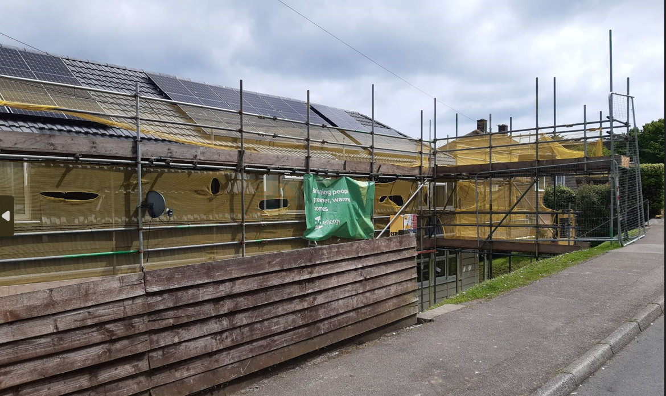
Inclusion Cornwall AGM – 29.09.23
Fuel Poverty, Inclusion Cornwall and Public Health
Winter Wellbeing

Slide 2

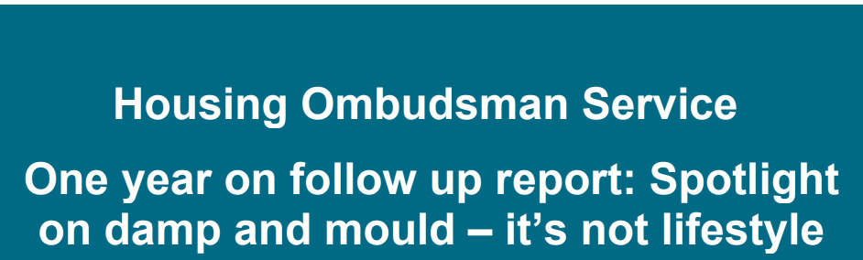
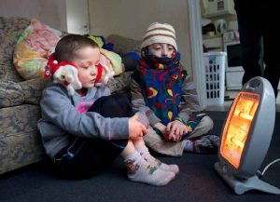
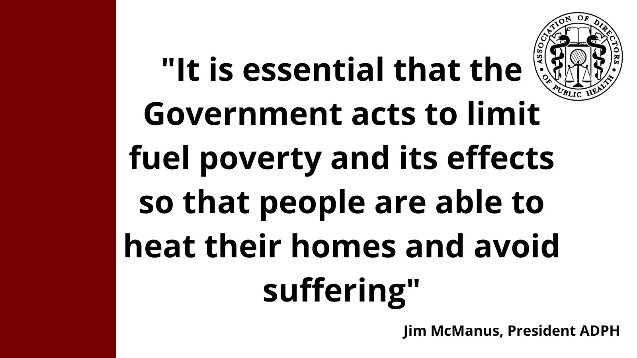
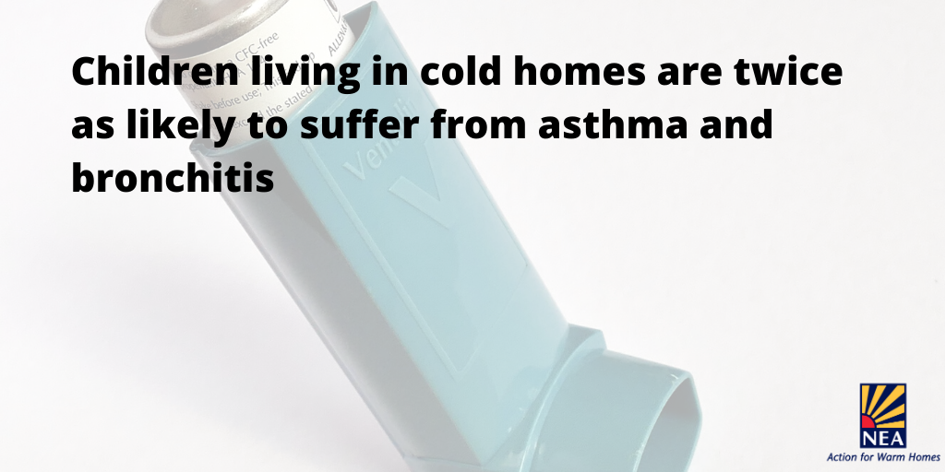
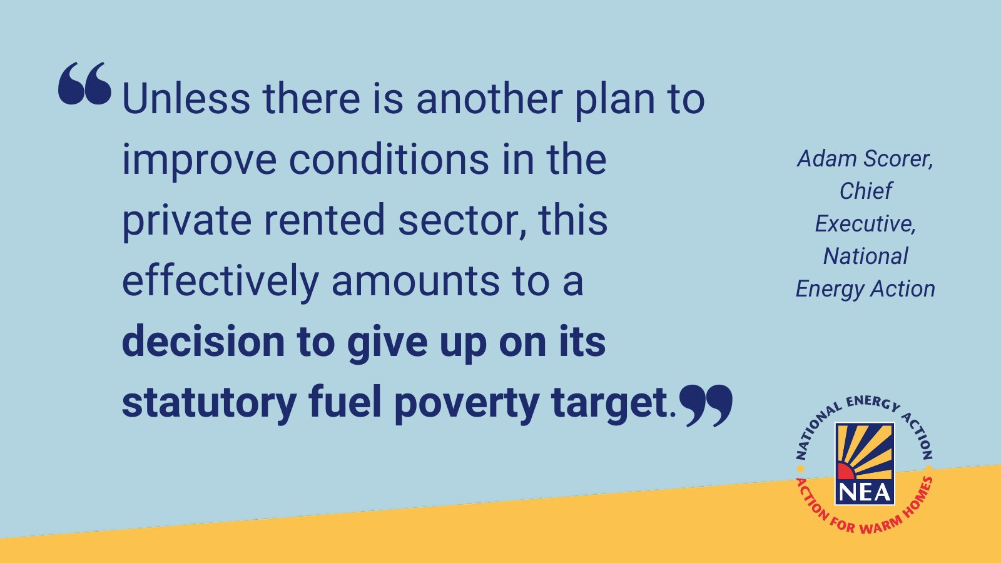
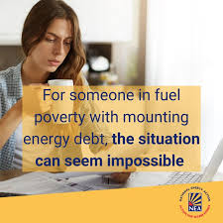
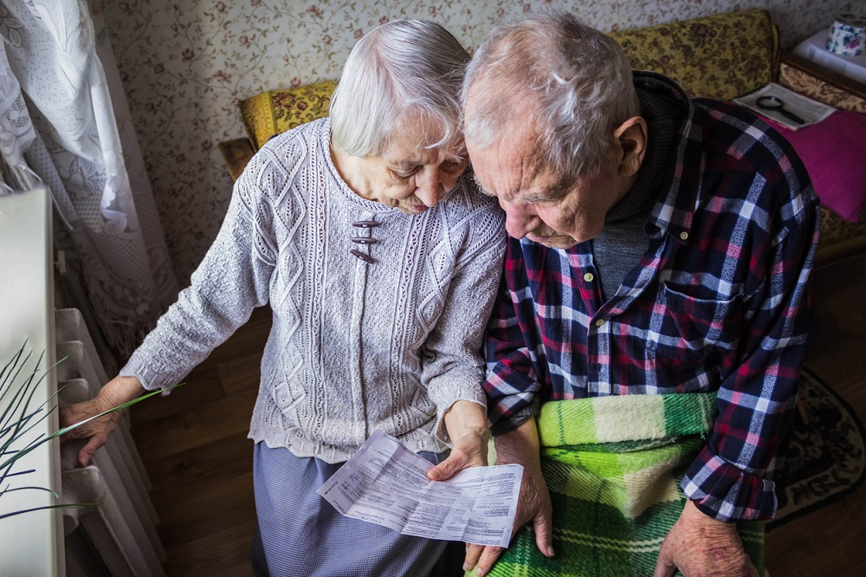
The right home environment protects and improves health and wellbeing. A warm, dry and secure home is associated with better health and prevents physical and mental ill health. Director of Public Health 2023 Annual Report
Notes:
In Cornwall fuel poverty affects over 12.6% of all households (32,367 homes). On the Isles of Scilly it is 11.7% (131 homes) - (BEIS Fuel Poverty statistics 2020). 3.5% of homes in Cornwall do not have central heating (2021 Census).

Slide 3
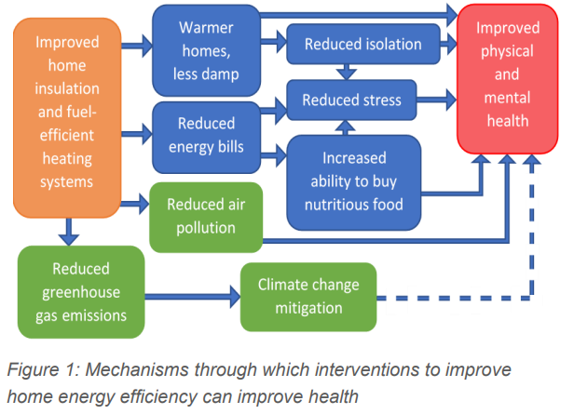
Cold homes have a wide range of impacts
Notes:
Cold homes have a wide range of impacts on both physical and mental health, and the health impacts of cold weather partially underlies the higher overall mortality rate seen in winter compared to other seasons.5 Some of the most common physical health impacts include respiratory conditions, and an increased risk of hypertension, heart attacks and stroke. Fuel poverty is a driver of health inequalities in both rural and urban areas.

Slide 4
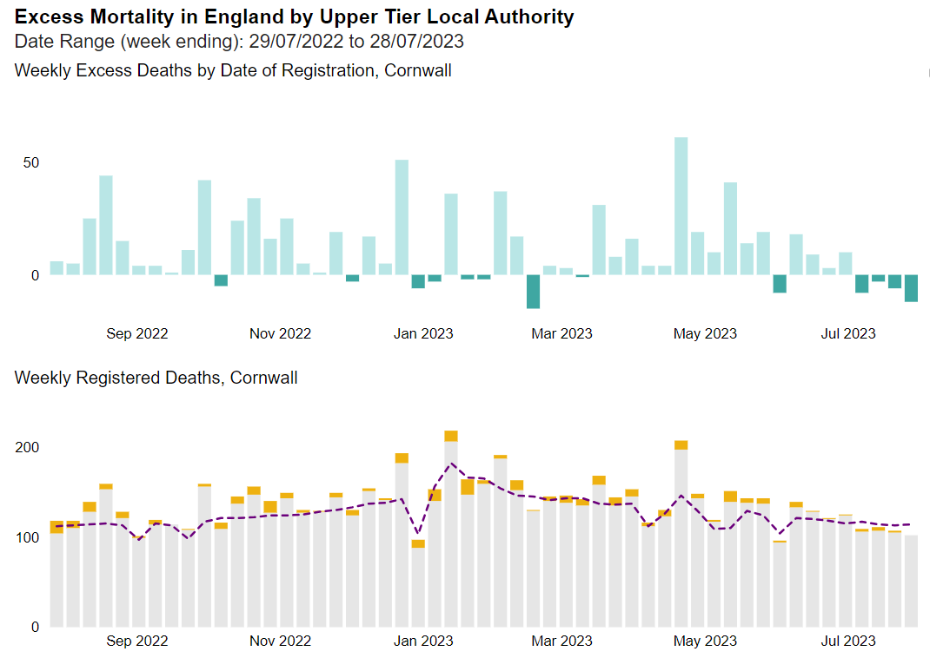
EXCESS DEATHS
Excess deaths are estimated by comparing the number of observed deaths during the period with the number of deaths that would have been expected based on the previous 5 years.
The numbers of expected deaths are estimated using statistical models and based on previous 5 years’ (2015 to 2019) mortality rates. Measuring excess mortality from all causes, instead of focusing solely on mortality from COVID-19, overcomes the issues of variation in testing and differential coding of cause of death between individuals and over time.
Excess mortality: Cornwall [29 July 2022 to 28 July 2023]
Location | Registered deaths | Expected deaths | Deaths with COVID-19 on the death certificate | Excess deaths | Ratio of registered or expected
Cornwall | 7,371 | 6,727 | 320 | 644 | 1.10
Across Cornwall and Isles of Scilly, there were 7,371 deaths during the period 29 July 2022 to 28 July 2023. It is estimated that during this period there were 644 excess deaths. This means that there were 644 more deaths than would have been expected when comparing the number of observed over this period with the number of deaths observed over the previous 5 years 2015 to 2019. Excess deaths are based on the assumption of an ‘average year’ given the trends in death rates and demographic change.
Notes:
Last year CIOS had 644 more deaths than would have been expected. If you travel just seven miles from Shortlanesend near Truro to Perranporth, life expectancy for women falls by 9 years, from 88 to 79. Healthy Life expectancy) is actually falling across Cornwall and the Isles of Scilly, with life expectancy stalling relative to long-run trends. The slowdown in life expectancy improvement has struck all age groups and disproportionately affected those in less affluent households and communities. Males in the most deprived areas of CIOS in 2020 are now expected to live for 0.6 years less than in 2010.
Cold Homes are a factor in this with the collective impact on society is significant too. £2.5bn is spent each year on health services in England on treating illness caused by cold homes.

Slide 5
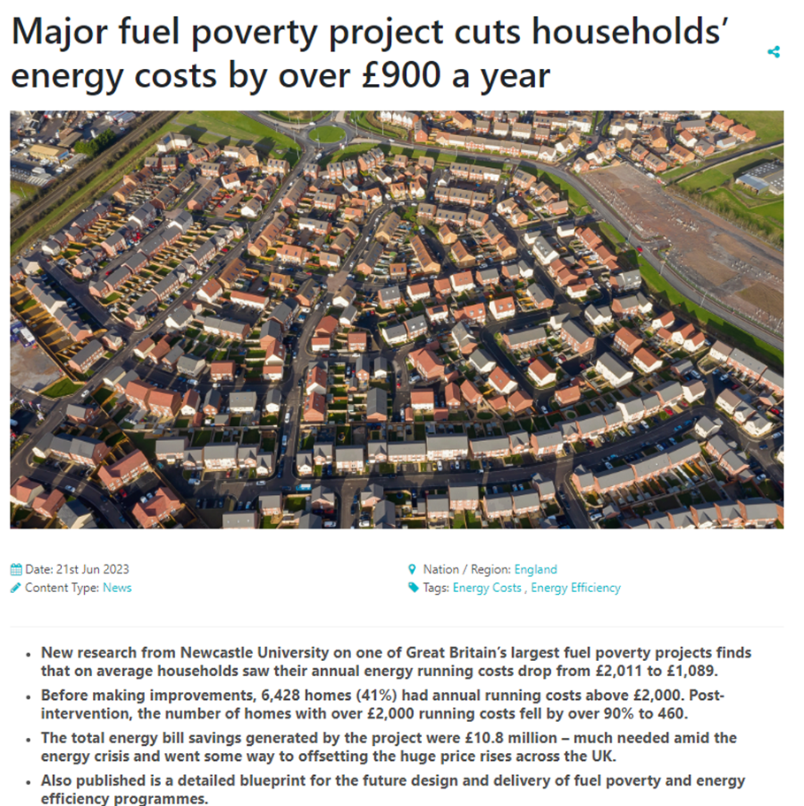
What are we doing ?
Lives are been cut short
People are dying earlier that they should
Good health, secure, warm homes and good work are all linked
Winter Wellbeing – prevention programme
Notes:
We’ve improved over 20,000 households lives so far, but many more to help. We’ve helped with advice and information, set up and run a partnership to seek to coordinate this activity. We help, through our Winter Wellbeing partners having commissioned Community Energy Plus to run the Winter Wellbeing advice line and OVO to deliver warmth to homes as well as many other activities and seek to mitigate the impact of cost of living issues – not an easy task but one we do and use this to challenge and guide the strategic approach. Now over to Dave to introduce and premiere the updated Winter Wellbeing film.

